Slide 1


Emotion Regulation Strategy
Use and Forecasting Using Dynamic, Feature-Rich Stimuli
Notes:
Hi everybody, Thank you so much for having me.
My name is Billy Mitchell I’m a PhD Candidate in Chelsea Helion’s SAN Lab at Temple University
and I’m going to talk a little bit about a project I’ve been working on for the last several years.
And I think many of the topics that you’re all interested in are pretty complementary to the constructs we were interested in this project
So I’d love to hear your thoughts on it.
Please feel free to interrupt with questions and comments as I go through.

Slide 2
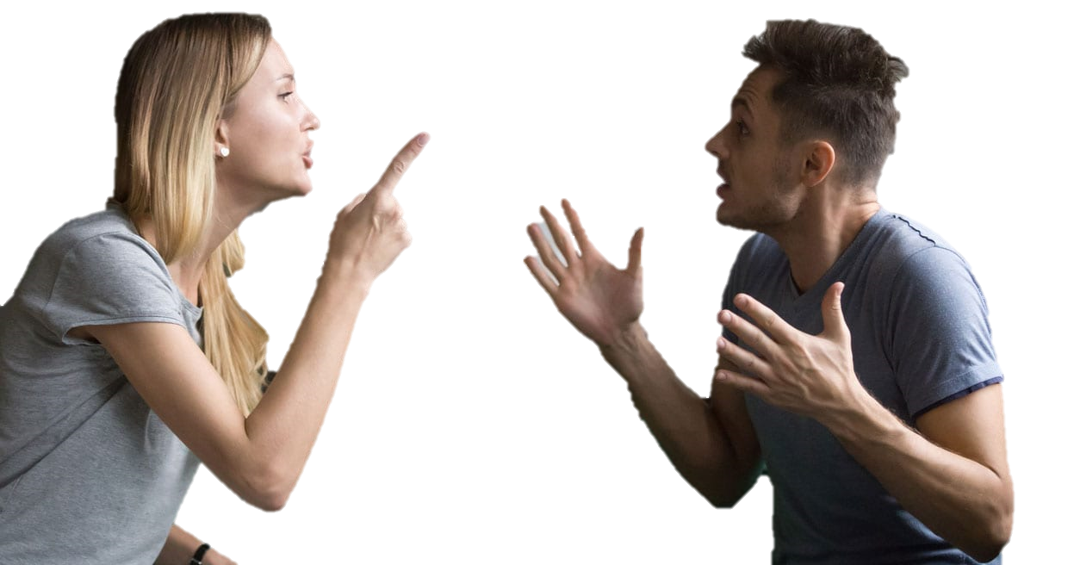
Notes:
Social conflict

Slide 3

Notes:
Physical threat

Slide 4

Events in our lives can be:
Intense
Notes:
Any other emotionally evocative stimuli

Slide 5

Events in our lives can be:
Intense
Uncertain

Slide 6

Events in our lives can be:
Intense
Uncertain
Dynamic

Slide 7

Events in our lives can be:
Intense
Uncertain
Dynamic
Complex

Slide 8
Regulation Strategy Use
Notes:
Realistic circumstances
Contextually sensitive

Slide 9
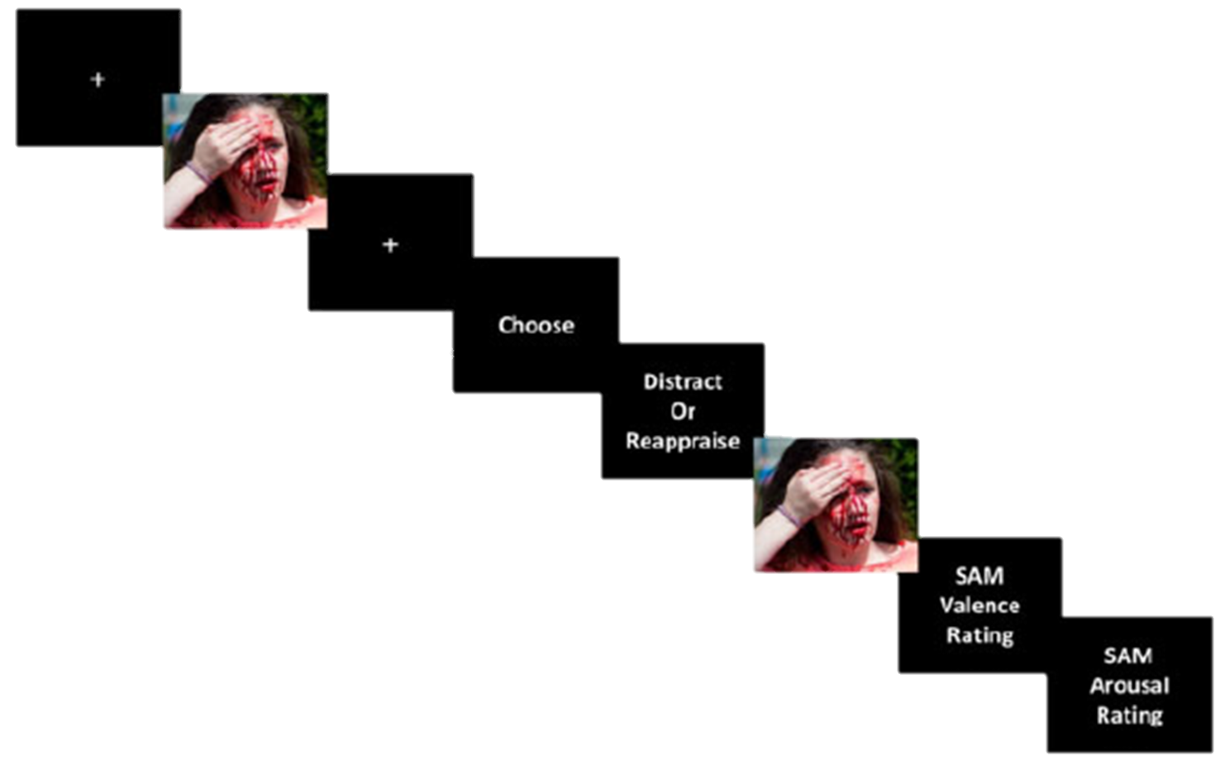
Regulation Strategy Choice
Regulation Strategy Use
Notes:
Idealized
Trained
Prompted

Slide 10



Regulation Strategy Choice
Regulation Strategy Use
Prioritizes Internal
Validity
Prioritizes
External
Validity

Slide 11
What can Emotion Regulation Strategy Choice tell us about Use when events are intense, uncertain, dynamic, and complex?

Slide 12
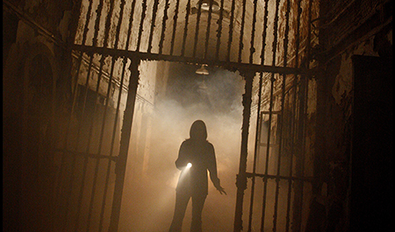




Threats in our lives can be:
Aversive
Notes:
aversive, you would probably not enjoy finding yourself in any of them

Slide 13
Threats in our lives can be:
Aversive
Unexpected
Notes:
They are largely unexpected, making it difficult to adequately prepare an appropriate response

Slide 14
Threats in our lives can be:
Aversive
Unexpected
Dynamic
Notes:
They are dynamic or in other words have some sort of a temporal component to them

Slide 15
Threats in our lives can be:
Aversive
Unexpected
Dynamic
Complex
Notes:
They are multidimensional, comprised of different sensory modalities

Slide 16


Threats in our lives can be:
Aversive
Unexpected
Dynamic
Complex
Compounded
Notes:
And they can be compounded. They don’t exist in isolation. One bad thing can snowball into another.
As I’m sure you all know, probably better than me,

Slide 17
Threats in our lives can be:
Aversive
Unexpected
Dynamic
Complex
Compounded
Notes:
all of these details make it really hard to study threat as it might exist in our daily lives,

Slide 18
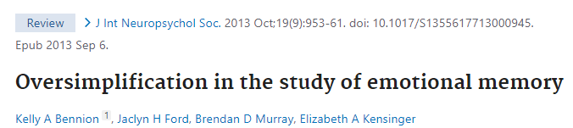
Notes:
But when under threat, people produce less veridical accounts of details involved in the event

Slide 19
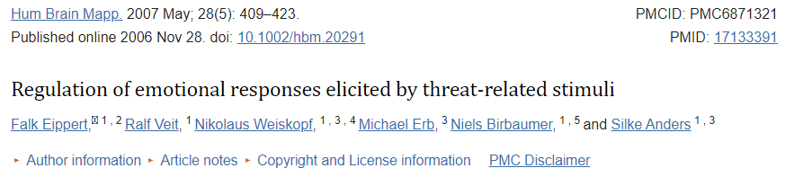
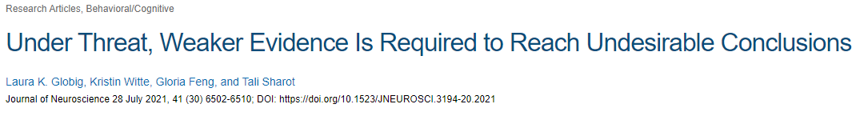
Notes:
Threat can lead us to make poor decisions when navigating the event as well as when making decisions following the event

Slide 20
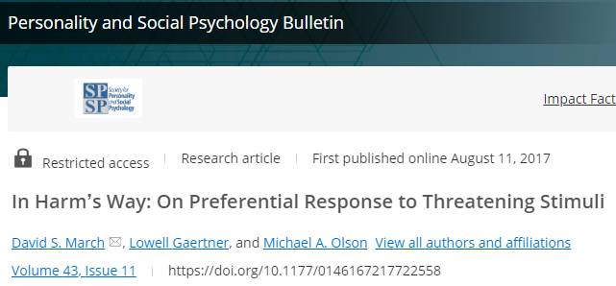
Notes:
And to top it all off,
your lab’s work has highlighted that the mere presence of threat
biases our attention to threat-related stimuli,
more so than explained by negative valence alone

Slide 21



Threat Management is relevant to:
Anxiety & Traumatic Stress Disorder
Prejudicial Attitudes
Fatal Police Shootings
Notes:
And so it seems that if we want solutions
or at least a better understanding of circumstances like
anxiety disorders, trauma responses,
prejudice, and deadly police interactions,

Slide 22
Aversive
Unexpected
Dynamic
Complex
Compounded
Threat Management is relevant to:
Anxiety & Traumatic Stress Disorder
Prejudicial Attitudes
Fatal Police Shootings
Notes:
which again can be aversive, unexpected, dynamic, complex, and compounded
we really need, in the opinion of this talk,
paradigms that incorporate these features
There has been a ton of really great work in this regard

Slide 23

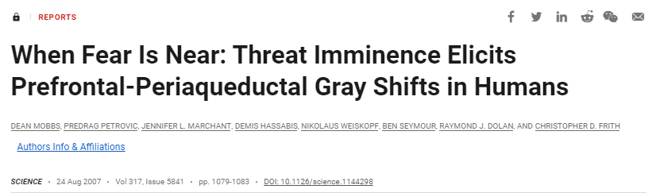


Notes:
The dean mobbs pac man shock experiment is a great example which has a very real physiological consequence for succumbing to or experiencing proximal and distal threats

Slide 24
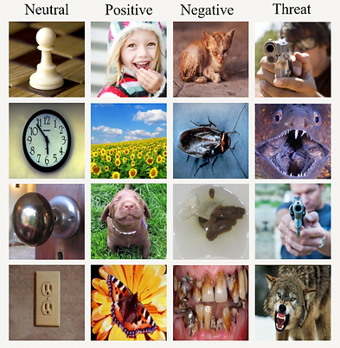
Notes:
The feature-richness and complexity of visual threat array that you had used to dissociate valence and threat is another great example
Or even the shooter task Vinny told me about at SISPP that I loved, though I unfortunately don’t have a graphic for it

Slide 25
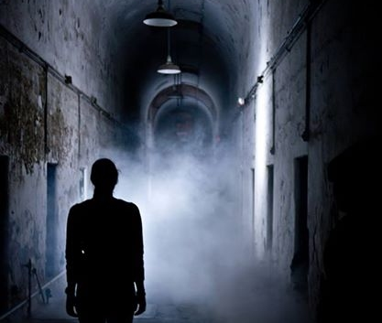
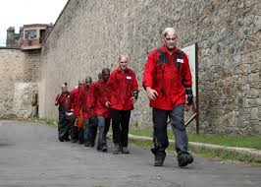
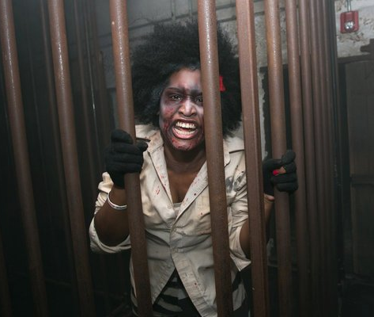
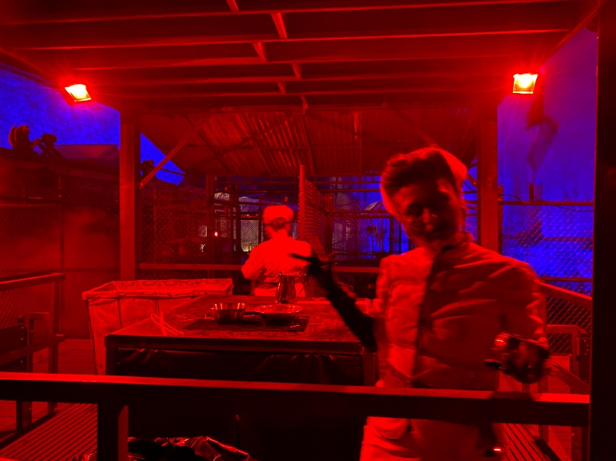
Notes:
and what I’ll talk to you all about today is what I think our contributions to this space have been.
I really don’t think there could be a better time for me to be || giving this talk because although

Slide 26
Notes:
a typical, well-adjusted person would likely never go seeking out any of these examples I’d mentioned,
This is a time of year when we actually do regularly seek out and engage with explicitly threatening stimuli
Of course, when we are engaging || with a grim future || , or violence ||, or social conflict in this context,
We are likely doing so from the comfort and safety of our own couch or an entertainment experience

Slide 27

Notes:
Although a typical, well-adjusted person would likely never go seeking out any of the previous examples I’d mentioned,
This is a time of year when we actually do regularly seek out and engage with explicitly threatening stimuli
Of course, when we are engaging || with a grim future || , or violence ||, or social conflict in this context,
We are likely doing so from the comfort and safety of our own couch or an entertainment experience

Slide 28

Notes:
Although a typical, well-adjusted person would likely never go seeking out any of the previous examples I’d mentioned,
This is a time of year when we actually do regularly seek out and engage with explicitly threatening stimuli
Of course, when we are engaging || with a grim future || , or violence ||, or social conflict in this context,
We are likely doing so from the comfort and safety of our own couch or an entertainment experience

Slide 29

Notes:
Although a typical, well-adjusted person would likely never go seeking out any of the previous examples I’d mentioned,
This is a time of year when we actually do regularly seek out and engage with explicitly threatening stimuli
Of course, when we are engaging || with a grim future || , or violence ||, or social conflict in this context,
We are likely doing so from the comfort and safety of our own couch or an entertainment experience

Slide 30
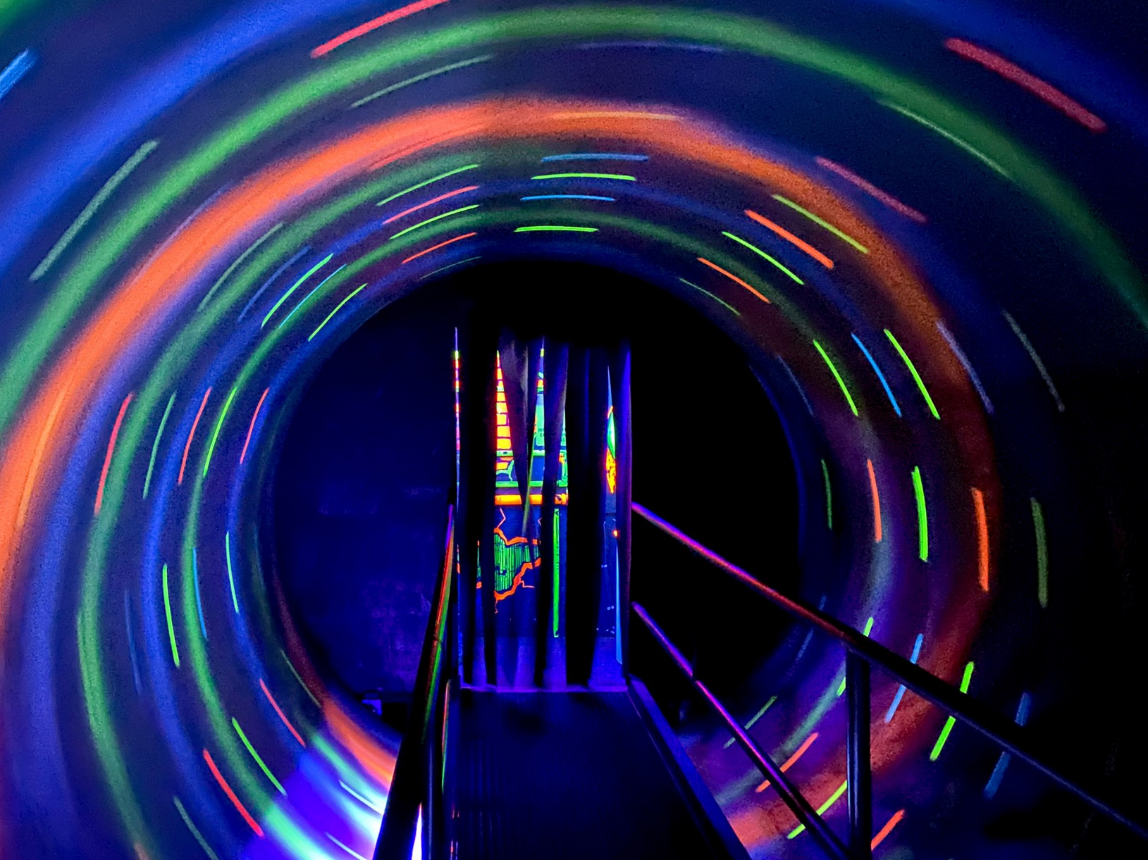

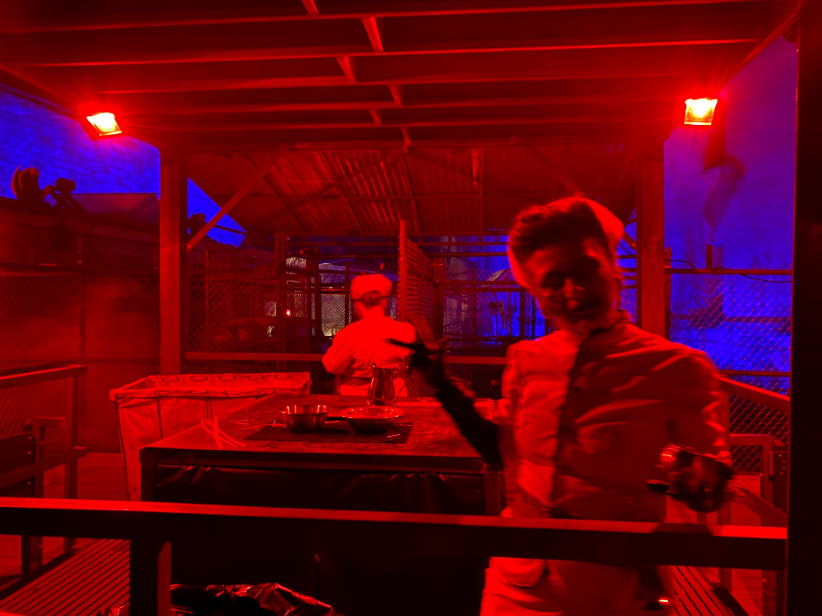
Notes:
And while this safety makes these situations categorically different from the threats I’d just talked about,
haunted house experiences incorporate all of the features that are otherwise hard to fit in a lab experiment.
They can be aversive, they are surprising, the events unfold over time, they often contain an ample and varied amount of auditory, visual, and sensory stimuli, and the events do not exist in isolation.
Here are a few examples of the sights that our participants experienced at Terror Behind the Walls, hosted at Eastern State Penitentiary in Philadelphia.

Slide 31
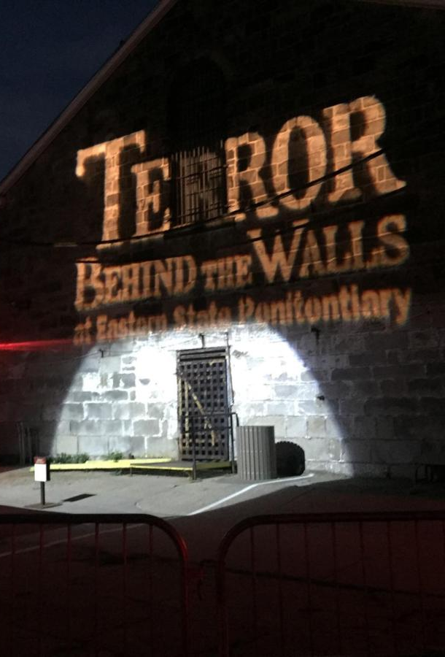
What can TBTW offer?
Feature-rich but controlled environment
Notes:
We chose Terror Behind the Walls as our setting for a few reasons
One, this environment can feel really overwhelming and chaotic, but it is completely controlled. Participants can feel in danger without being in any real danger

Slide 32
What can TBTW offer?
Feature-rich but controlled environment
Limited researcher intervention
Notes:
Relatedly, it can be very easy to forget that you are participating in a study at terror behind the walls.
Because of fantastic coordination between our team and the people operating this,
we did not need a lot of researcher participant interaction during exposure
And our participants could focus on trying to have as typical of a response as the situation would allow

Slide 33
What can TBTW offer?
Feature-rich but controlled environment
Limited researcher intervention
Performances are reliably consistent
Notes:
We did not need to worry about significant variance in participant experiences
The TBTW team let our participants skip lines to ensure that
all of their highly trained professional actors were in the same marks every time

Slide 34
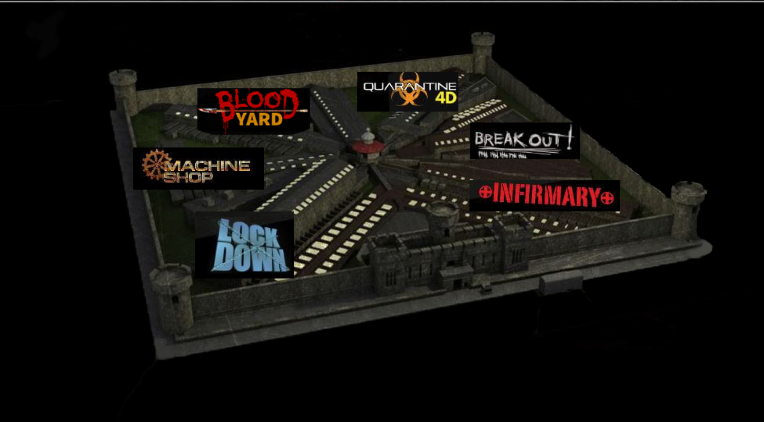
What can TBTW offer?
Feature-rich but controlled environment
Limited researcher intervention
Performances are reliably consistent
Great stimuli variability
Notes:
The TBTW experiences was divided into themed sections which provided a lot of different experiences
Making it likely that nearly everyone would have at least have a reaction to something

Slide 35
What can TBTW offer?
Feature-rich but controlled environment
Limited researcher intervention
Performances are reliably consistent
Great stimuli variability
Heightened complexity, dynamic interactions, and high-intensity threats in a safe environment
Notes:
and we found that degree to which participants reported highly intense affective responses while still being in no real danger
was far better than what we were able to achieve within the lab

Slide 36
Great, but what on earth did you actually study?!?
Notes:
But so all of this preamble begs the question, what did we actually do at Eastern State Penitentiary?
What did we actually study?

Slide 37




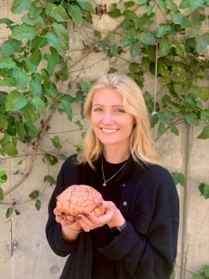





Principal Investigators
Chelsea Helion
Vishnu Murty
Temple University
Temple University
Joanne Stasiak
Billy Mitchell
Kate Cliver
David Gregory
Steven Martinez
Sam Reisman
UC Santa Barbara
Temple University
Drexel University
Temple University
Temple University
Brown University
‘How does physiological activation influence the metacognitive memory of emotional experiences over time?`
‘How do untrained people self-regulate during high-intensity threat?`
‘How do physiological representations of threat predict temporal memory?`
‘How does threat shape item-temporal memory binding?`
‘How does social media shape memory encoding for high intensity events?`
‘How does arousal and uncertainty intolerance bias episodic memory?`
Notes:
This is a very complicated question, because this project unfolded over several years with multiple people and multiple experiments.
In the original version of this talk I was actually going to touch briefly upon all of them
but I found myself running out of time just talking about the stuff that I led
So instead I’m just flashing some brief descriptions on the screen for you. These all are either preprints or published or in revision
So if you’re interested in hearing any more about them, let me know and I can talk about it at the end or direct you to the relevant materials

Slide 38
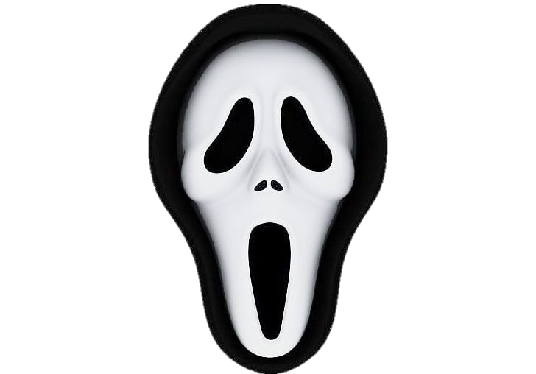

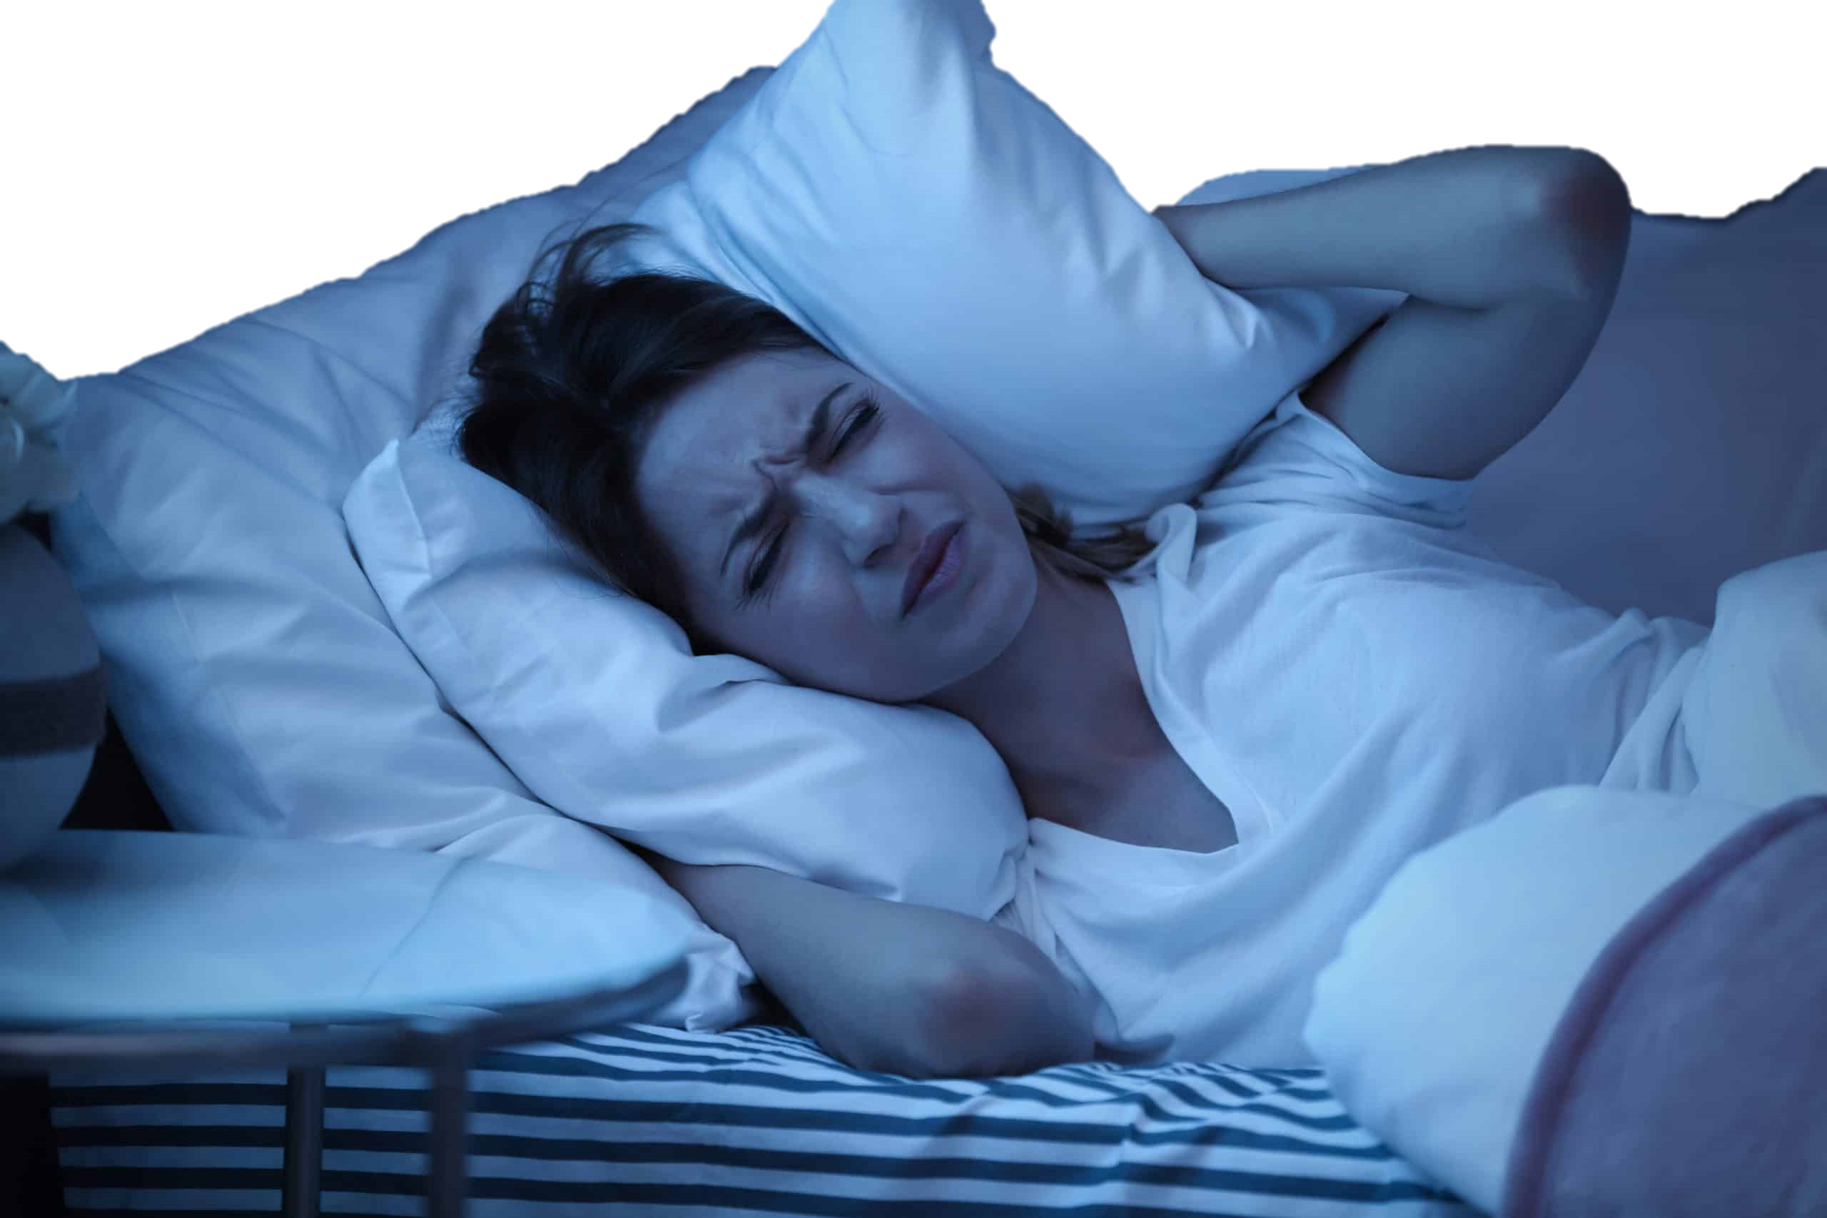
What did this project teach us happens …
During threats
After threats
Emotion regulation is complex and colored by environmental affordances
Memory accuracy improves for some things and worsens for others
Notes:
While I think many of my collaborators found some interesting results regarding what happens after threats have finished

Slide 39
What did this project teach us happens …
During threats
After threats
Emotion regulation is complex and colored by environmental affordances
Memory accuracy improves for some things and worsens for others
Notes:
Today I’m going to talk to you specifically about what I think this project taught us happens while threats are occurring
And my interests and efforts mostly centered around the emotional and self-regulatory experiences people underwent
As you might be able to guess from the title of the talk

Slide 40
What is emotion regulation?
Notes:
But I should probably briefly start by defining emotion regulation

Slide 41
What is emotion regulation?
The processes by which we influence which emotions we have, when we have them, and how we experience and express them.¹
¹Gross, 1998
Notes:
Most commonly, emotion regulation can be thought of as The processes by which we influence which emotions we have, when we have them, and how we experience and express them
How people might regulate is most commonly classified by strategy,

Slide 42
What is emotion regulation?
“They’re just actors; they can’t really hurt me.”
The processes by which we influence which emotions we have, when we have them, and how we experience and express them.¹
¹Gross, 1998
Notes:
so if someone were to reevaluate a scary movie by reminding themselves that it’s all just actors, they might be engaging in reappraisal

Slide 43
What is emotion regulation?
“They’re just actors; they can’t really hurt me.”
The processes by which we influence which emotions we have, when we have them, and how we experience and express them.¹
“I’m just going to look off screen for a second while this plays out ”
¹Gross, 1998
Notes:
If they were to divert their attention to a less aversive stimulus, we might say that they are using distraction

Slide 44
What is emotion regulation?
“They’re just actors; they can’t really hurt me.”
The processes by which we influence which emotions we have, when we have them, and how we experience and express them.¹
“I’m just going to look off screen for a second while this plays out ”
“I’m not scare. I’m not scared. I’m not scared …”
¹Gross, 1998
Notes:
And if they try to just white knuckle their feelings, we might say that they are engaging in suppression

Slide 45
Strategy-Situation Fit Hypothesis
Strategies have inherent strengths and weaknesses; adaptive usage is key.²
² Bonanno, 2013
Notes:
The strategy situation fit hypothesis of emotion regulation proposes that these strategies have their own strengths and weaknesses
and should be used like tools in a tool box to maximize positive outcomes.

Slide 46
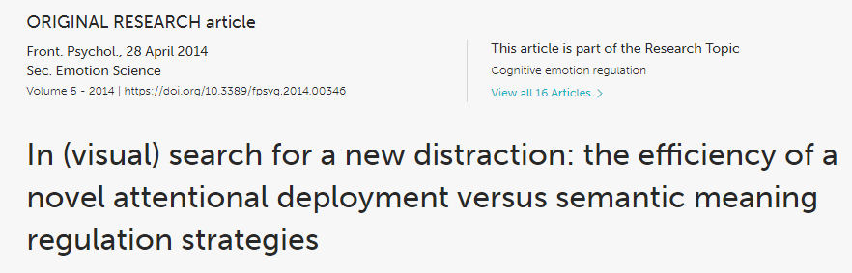
Strategy-Situation Fit Hypothesis
Strategies have inherent strengths and weaknesses; adaptive usage is key.²
² Bonanno, 2013
Notes:
The most well established association is between that of affective intensity and strategy choice.
As affective intensity increases, the efficacy of engagement strategies like reappraisal decreases,
so people more often choose disengagement strategies like distraction which are more effective at higher intensities

Slide 47
Strategy-Situation Fit Hypothesis
Strategies have inherent strengths and weaknesses; adaptive usage is key.²
3-6
³ Ilan et al., 2019
⁴ Shafir et al., 2016
⁵ Sheppes et al., 2011
⁶ Ochsner et al., 2002
Notes:
Paradigms like the one I have shown here
First briefly preview emotionally || evocative stimuli to participants
Before they are prompted to choose || one of two regulation strategies to use
They then see the image again || and regulate using their chosen strategy
Before reporting which strategy those chose and how it affected the affective experience.

Slide 48
Strategy-Situation Fit Hypothesis
Strategies have inherent strengths and weaknesses; adaptive usage is key.²
3-6
³ Ilan et al., 2019
⁴ Shafir et al., 2016
⁵ Sheppes et al., 2011
⁶ Ochsner et al., 2002
Notes:
Paradigms like the one I have shown here
First briefly preview emotionally || evocative stimuli to participants
Before they are prompted to choose || one of two regulation strategies to use
They then see the image again || and regulate using their chosen strategy
Before reporting which strategy those chose and how it affected the affective experience.

Slide 49
Strategy-Situation Fit Hypothesis
Strategies have inherent strengths and weaknesses; adaptive usage is key.²
3-6
³ Ilan et al., 2019
⁴ Shafir et al., 2016
⁵ Sheppes et al., 2011
⁶ Ochsner et al., 2002
Notes:
Paradigms like the one I have shown here
First briefly preview emotionally || evocative stimuli to participants
Before they are prompted to choose || one of two regulation strategies to use
They then see the image again || and regulate using their chosen strategy
Before reporting both which strategy those chose and how it influenced the affective experience.

Slide 50
Strategy-Situation Fit Hypothesis
Strategies have inherent strengths and weaknesses; adaptive usage is key.²
3-6
³ Ilan et al., 2019
⁴ Shafir et al., 2016
⁵ Sheppes et al., 2011
⁶ Ochsner et al., 2002
Notes:
Paradigms like the one I have shown here
First briefly preview emotionally || evocative stimuli to participants
Before they are prompted to choose || one of two regulation strategies to use
They then see the image again || and regulate using their chosen strategy
Before reporting both which strategy those chose and how it influenced the affective experience.

Slide 51
Strategy-Situation Fit Hypothesis
Strategies have inherent strengths and weaknesses; adaptive usage is key.²
The association between intensity and regulation choice in this paradigm is “ very large” (i.e., r+ = 0.46 – 0.61) ⁷
3-6
⁷ Matthews et al., 2021
Notes:
This simple design has been very fruitful and established a quite large effect size between intensity and regulation choice.
But self-regulation within this design differs markedly from how we self-regulate in our daily lives

Slide 52

Participants are trained in regulatory strategies and prompted to regulate
Broader population is largely strategy-naïve.
Artificial nature of experimental designs
Findings may not be applicable to emotion regulation outside of the lab
Meta-analyses suggest flaws in common emotion regulation paradigms ⁸
Suggests surveys are strong, but tasks lack internal validity
Naturalistic studies limited to Experiential Sampling
Limited in scope, mild emotional experiences
⁸ Eisenberg et al. (2019).
Notes:
Namely, participants are still trained in regulation strategies and prompted to regulate.
When someone cuts you off in traffic or feels insulted,
we have don’t know if these individuals would use these methods or regulate at all if not instructed to.
People aren’t often to think about self-regulation in these terms.

Slide 53
Participants are trained in regulatory strategies and prompted to regulate
Broader population is largely strategy-naïve.
Design features artificially constrained self-regulatory choice
Findings may not be applicable to emotion regulation outside of the lab
Meta-analyses suggest flaws in common emotion regulation paradigms ⁸
Suggests surveys are strong, but tasks lack internal validity
Naturalistic studies limited to Experiential Sampling
Limited in scope, mild emotional experiences
⁸ Eisenberg et al. (2019).
Notes:
Additionally, we know from study designs that do not artificially limit how people regulate that,
when allowed,
people often try multiple strategies for the same event.
The paradigms I just highlighted almost exclusively study distraction and reappraisal.
In reality, people use idiosyncratic strategies that don’t fit in the Gross model,
And they can experiment quite a bit with strategies to find the one that works for them

Slide 54
Participants are trained in regulatory strategies and prompted to regulate
Broader population is largely strategy-naïve.
Design features artificially constrained self-regulatory choice
Findings may not be applicable to emotion regulation outside of the lab
Meta-analyses suggest flaws in common emotion regulation paradigms ⁸
Suggests surveys are strong, but tasks lack internal validity
Naturalistic studies limited to Experiential Sampling
Limited in scope, mild emotional experiences
⁸ Eisenberg et al. (2019).
Notes:
Concerns about the validity of these tasks has been supported by meta-analyses which have found a lack of internal validity across tasks in the pre-existing self-regulation paradigms

Slide 55
Participants are trained in regulatory strategies and prompted to regulate
Broader population is largely strategy-naïve.
Design features artificially constrained self-regulatory choice
Findings may not be applicable to emotion regulation outside of the lab
Meta-analyses suggest flaws in common emotion regulation paradigms ⁸
Suggests surveys are strong, but tasks lack internal validity
Naturalistic studies limited to Experiential Sampling
Limited in scope, mild emotional experiences
⁸ Eisenberg et al. (2019).
Notes:
And lastly, attempts to improve upon these designs by using experiential sampling methods have been really great, but they can often be limited scope and now well suited to capture high-intensity emotion regulation

Slide 56
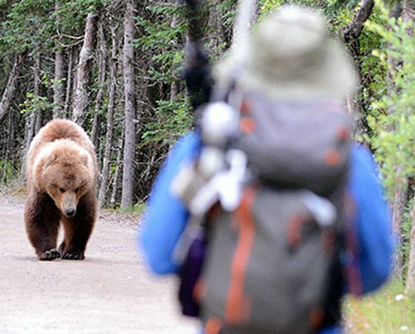

Notes:
And might miss situations when when self-regulation,
or keeping our cool,
matters most:
in risky and high-stress situations
And so what we aimed to do was a bit different than the pre-eminent paradigm

Slide 57
Will people self-regulate their emotions?
What will influence their self-regulation behavior?
Notes:
I really wanted to see,
when I don’t train people,
when they aren’t constrained to two strategies,
when I don’t prompt them to regulate,
when they’re in really challenging circumstances,
will they self-regulate,
how will they self-regulate,
and what will influence their self-regulation?

Slide 58
Pilot
(N = 58)
Study 2
(N = 154)
Study 1
(N = 118)
Study 3
(N = 300)
Notes:
So the first thing we did in 2019 was a pilot study in which participants traversed the full 45 minute haunted house experience
We based our a priori power analysis on the most conservative effect size that we could observe at the time,
which suggested that we should be able to sufficiently power this study with just 18 participants.
Obviously given the additional complications
and the fact that others had questions that required greater power,
we aimed for 60 participants and got 58.

Slide 59
Pilot
(N = 58)
Study 2
(N = 154)
Instructed to experience haunted house naturally
No emotion regulation training
Identified ten most emotionally-salient events
Recorded affective intensity, regulation effort and described strategy in their own words for each event
Strategies were coded (IRR = 0.881)
Study 1
(N = 118)
Study 3
(N = 300)
Notes:
These participants were given minimal instructions and information before entering the haunted house.

Slide 60
Pilot
(N = 58)
Study 2
(N = 154)
Instructed to experience haunted house naturally
No emotion regulation training
Identified ten most emotionally-salient events
Recorded affective intensity, regulation effort and described strategy in their own words for each event
Strategies were coded (IRR = 0.881)
Study 1
(N = 118)
Study 3
(N = 300)
Notes:
Emotion regulation was never mentioned and participants were not trained in strategies

Slide 61
Pilot
(N = 58)
Study 2
(N = 154)
Instructed to experience haunted house naturally
No emotion regulation training
Identified ten most emotionally-salient events
Recorded affective intensity, regulation effort and described strategy in their own words for each event
Strategies were coded (IRR = 0.881)
Study 1
(N = 118)
Study 3
(N = 300)
Notes:
Instead, after the full experience,
participants were asked to self-identify ten events from the haunted house
that were most emotionally salient to them

Slide 62
Pilot
(N = 58)
Study 2
(N = 154)
Instructed to experience haunted house naturally
No emotion regulation training
Identified ten most emotionally-salient events
Recorded affective intensity, regulation effort and described strategy in their own words for each event
Strategies were coded (IRR = 0.881)
Study 1
(N = 118)
Study 3
(N = 300)
Notes:
They identified which emotions they felt from 14 options sourced from the PANAS,
how intense they felt those emotions,
and then, in a free response box,
were asked to describe how they attempted to self-regulate those emotions if they did at all.
They also completed a number of individual difference measures.

Slide 63
Pilot
(N = 58)
Study 2
(N = 154)
Instructed to experience haunted house naturally
No emotion regulation training
Identified ten most emotionally-salient events
Recorded affective intensity, regulation effort and described strategy in their own words for each event
Strategies were coded (IRR = 0.881)
Study 1
(N = 118)
Study 3
(N = 300)
Notes:
Those strategy responses were then coded by a team of independent,
hypothesis-blind raters trained to identify strategies.
And from there what I really wanted to establish was just whether this paradigm has any legs.
Can we study self-regulation in this way?
And so what did we find?

Slide 64
When feeling threatened, people self-regulated
People who do not enjoy haunted houses report regulating more events within the haunted house. r² adj. = 0.242

Slide 65
When feeling threatened, people self-regulated
People who do not enjoy haunted houses regulate more events within the haunted house. r² adj. = 0.242

Slide 66
When feeling threatened, people self-regulated
People who do not enjoy haunted houses regulate more events within the haunted house. r² adj. = 0.242
As startle sensitivity increases, the number of regulated events within the haunted house increases. r² adj. = 0.085

Slide 67
When feeling threatened, people self-regulated
People who do not enjoy haunted houses regulate more events within the haunted house. r² adj. = 0.242
As startle sensitivity increases, the number of regulated events within the haunted house increases. r² adj. = 0.085

Slide 68
When feeling threatened, people self-regulated
People who do not enjoy haunted houses regulate more events within the haunted house. r² adj. = 0.242
As startle sensitivity increases, the number of regulated events within the haunted house increases. r² adj. = 0.085
As anxiety increased within the haunted house, so did participants’ self-reported efforts to emotionally regulate. r² adj. = 0.095

Slide 69
When feeling threatened, people self-regulated
People who do not enjoy haunted houses regulate more events within the haunted house. r² adj. = 0.242
As startle sensitivity increases, the number of regulated events within the haunted house increases. r² adj. = 0.085
As anxiety increased within the haunted house, so did participants’ self-reported efforts to emotionally regulate. r² adj. = 0.095

Slide 70
When feeling threatened, people self-regulated
People who do not enjoy haunted houses regulate more events within the haunted house. r² adj. = 0.242
As startle sensitivity increases, the number of regulated events within the haunted house increases. r² adj. = 0.085
As anxiety increased within the haunted house, so did participants’ self-reported efforts to emotionally regulate. r² adj. = 0.095
As negative affective intensity increased, people put more effort towards regulating their emotions.

Slide 71
When feeling threatened, people self-regulated
People who do not enjoy haunted houses regulate more events within the haunted house. r² adj. = 0.242
As startle sensitivity increases, the number of regulated events within the haunted house increases. r² adj. = 0.085
As anxiety increased within the haunted house, so did participants’ self-reported efforts to emotionally regulate. r² adj. = 0.095
As negative affective intensity increased for a given event, people put more effort towards regulating their emotions during that event.

Slide 72
What did this project teach us happens …
During threats
Emotion regulation is complex and colored by environmental affordances
People spontaneously self-regulated their emotions when feeling threatened
Notes:
and so I felt fairly convinced that we are seeing spontaneous self-regulation here
When we ran our analysis to examine whether this affective intensity predicted strategy usage, we failed to find a relationship
But there were a number of issues with this study design
[DELAY IN TIME]
[SMALL SAMPLE SIZE]
[PRESECRIBED EMOTIONS]

Slide 73
Pilot
(N = 58)
Study 2
(N = 154)
Largely the same as Pilot except no time lag
Emotions were also free-response
Strategies were coded again (IRR = 0.877)
Instructed to experience haunted house naturally
No emotion regulation training
Identified ten most emotionally-salient events
Recorded affective intensity, regulation effort and described strategy in their own words for each event
Strategies were coded (IRR = 0.881)
Study 1
(N = 118)
Study 3
(N = 300)
Notes:
This time we included 118 people
Using observed effect from pilot
No time lag

Slide 74
Pilot
(N = 58)
Study 2
(N = 154)
Largely the same as Pilot except no time lag
Emotions were also free-response
Strategies were coded again (IRR = 0.877)
Instructed to experience haunted house naturally
No emotion regulation training
Identified ten most emotionally-salient events
Recorded affective intensity, regulation effort and described strategy in their own words for each event
Strategies were coded (IRR = 0.881)
Study 1
(N = 118)
Study 3
(N = 300)

Slide 75
Pilot
(N = 58)
Study 2
(N = 154)
Largely the same as Pilot except no time lag
Emotions were also free-response
Strategies were coded again (IRR = 0.877)
Instructed to experience haunted house naturally
No emotion regulation training
Identified ten most emotionally-salient events
Recorded affective intensity, regulation effort and described strategy in their own words for each event
Strategies were coded (IRR = 0.881)
Study 1
(N = 118)
Study 3
(N = 300)

Slide 76
We are certainly self-regulating, but how we do so is complicated ...
Affective intensity did not predict which strategy participants used when regulating their emotions in this context.

Slide 77
We are certainly self-regulating, but how we do so is complicated ...
Affective intensity did not predict which strategy participants used when regulating their emotions in this context.

Slide 78
We are certainly self-regulating, but how we do so is complicated ...
Affective intensity did not predict which strategy participants used when regulating their emotions in this context.
This was true even when taking a multiverse approach and adjusting for known covariates including cognitive load, sex, and ERQ scores.

Slide 79
We are certainly self-regulating, but how we do so is complicated ...
Affective intensity did not predict which strategy participants used when regulating their emotions in this context.
This was true even when taking a multiverse approach and adjusting for known covariates including cognitive load, sex, and ERQ scores.
This does not mean that the effect is not present, but that the association between the two topics is likely very overstated.
Notes:
[BEFORE MOVING ON] and again, this is replicating what we found in our pilot

Slide 80
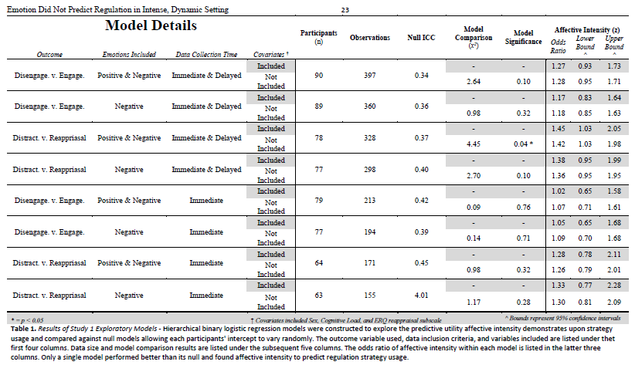

Slide 81
At least part of the reason that it may be complicated is that ...
Reappraisal performed about evenly at all levels of intensity, while distraction got worse as intensity increases
This is contrary to what previous lab research might suggest

Slide 82
At least part of the reason that it may be complicated is that ...
Reappraisal performed about evenly at all levels of intensity, while distraction got worse as intensity increases
This is contrary to what previous lab research might suggest

Slide 83
What did this project teach us happens …
During threats
Emotion regulation is complex and colored by environmental affordances
People spontaneously self-regulated their emotions when feeling threatened
How people self-regulated their emotions was not significantly predicted by individual differences, affective intensity, cognitive load, or any other factor we commonly examine in the lab

Slide 84
What did this project teach us happens …
During threats
Emotion regulation is complex and colored by environmental affordances
People spontaneously self-regulated their emotions when feeling threatened
How people self-regulated their emotions was not significantly predicted by individual differences, affective intensity, cognitive load, or any other factor we commonly examine in the lab
Notes:
And so the second thing I think we can take away here
[TALK]
But where does that leave us?
A null effect is not very exciting and doesn’t really tell us much

Slide 85
Pilot
(N = 58)
Study 2
(N = 154)
Largely the same as Pilot except no time lag
Emotions were also free-response
Strategies were coded again (IRR = 0.877)
Instructed to experience haunted house naturally
No emotion regulation training
Identified ten most emotionally-salient events
Recorded affective intensity, regulation effort and described strategy in their own words for each event
Strategies were coded (IRR = 0.881)
Conducted entirely online with people who had never seen the haunted house
Fed descriptions of events, affective information,
Asked to predict which strategy they would have used.
More closely mirrors the stimulus-response paradigms
Study 1
(N = 118)
Study 3
(N = 300)

Slide 86
Pilot
(N = 58)
Study 2
(N = 154)
Largely the same as Pilot except no time lag
Emotions were also free-response
Strategies were coded again (IRR = 0.877)
Instructed to experience haunted house naturally
No emotion regulation training
Identified ten most emotionally-salient events
Recorded affective intensity, regulation effort and described strategy in their own words for each event
Strategies were coded (IRR = 0.881)
Conducted entirely online with people who had never seen the haunted house
Fed descriptions of events, affective information,
Asked to predict which strategy they would have used.
More closely mirrors the stimulus-response paradigms
Study 1
(N = 118)
Study 3
(N = 300)

Slide 87
Pilot
(N = 58)
Study 2
(N = 154)
Largely the same as Pilot except no time lag
Emotions were also free-response
Strategies were coded again (IRR = 0.877)
Instructed to experience haunted house naturally
No emotion regulation training
Identified ten most emotionally-salient events
Recorded affective intensity, regulation effort and described strategy in their own words for each event
Strategies were coded (IRR = 0.881)
Conducted entirely online with people who had never seen the haunted house
Fed descriptions of events, affective information,
Asked to predict which strategy they would have used.
More closely mirrors the stimulus-response paradigms
Study 1
(N = 118)
Study 3
(N = 300)

Slide 88
Pilot
(N = 58)
Study 2
(N = 154)
Largely the same as Pilot except no time lag
Emotions were also free-response
Strategies were coded again (IRR = 0.877)
Instructed to experience haunted house naturally
No emotion regulation training
Identified ten most emotionally-salient events
Recorded affective intensity, regulation effort and described strategy in their own words for each event
Strategies were coded (IRR = 0.881)
Conducted entirely online with people who had never seen the haunted house
Fed descriptions of events, affective information,
Asked to predict which strategy they would have used.
More closely mirrors the stimulus-response paradigms
Study 1
(N = 118)
Study 3
(N = 300)

Slide 90
When threats are distal (i.e., forecasted), as they may feel in some lab studies ...
We see a similar pattern of results to what ER researchers have canonically found (albeit, a much weaker association); increased affective intensity predicts a greater likelihood of selecting distraction instead of reappraisal
OR = 1.06, 95% CI = [1.02, 1.10], p = 0.004
Notes:
, likely because Forecasters were specifically using the strategy at higher intensities; the situation which experiencers found themselves the least likely to successfully deploy distraction.
, which might makes sense if we have one group effectively choosing reappraisal at chance

Slide 91
When threats are distal (i.e., forecasted), as they may feel in some lab studies ...
We see a similar pattern of results to what ER researchers have canonically found (albeit, a much weaker association); increased affective intensity predicts a greater likelihood of selecting distraction instead of reappraisal
OR = 1.06, 95% CI = [1.02, 1.10], p = 0.004
These differences were not explained by differences between the samples in ERQ, DERS, or IUS
Notes:
, likely because Forecasters were specifically using the strategy at higher intensities; the situation which experiencers found themselves the least likely to successfully deploy distraction.
, which might makes sense if we have one group effectively choosing reappraisal at chance

Slide 92
When threats are distal (i.e., forecasted), as they may feel in some lab studies ...
We see a similar pattern of results to what ER researchers have canonically found (albeit, a much weaker association); increased affective intensity predicts a greater likelihood of selecting distraction instead of reappraisal
OR = 1.06, 95% CI = [1.02, 1.10], p = 0.004
These differences were not explained by differences between the samples in ERQ, DERS, or IUS
Forecasters matched Reappraisal at about chance. However, forecasters matched Distraction below chance
Notes:
, likely because Forecasters were specifically using the strategy at higher intensities; the situation which experiencers found themselves the least likely to successfully deploy distraction.
, which might makes sense if we have one group effectively choosing reappraisal at chance

Slide 93
When threats are distal (i.e., forecasted), as they may feel in some lab studies ...
We see a similar pattern of results to what ER researchers have canonically found (albeit, a much weaker association); increased affective intensity predicts a greater likelihood of selecting distraction instead of reappraisal
OR = 1.06, 95% CI = [1.02, 1.10], p = 0.004
These differences were not explained by differences between the samples in ERQ, DERS, or IUS
Forecasters matched Reappraisal at about chance. However, forecasters matched Distraction below chance
Notes:
, likely because Forecasters were specifically using the strategy at higher intensities; the situation which experiencers found themselves the least likely to successfully deploy distraction.
, which might makes sense if we have one group effectively choosing reappraisal at chance

Slide 94
What did this project teach us happens …
During threats
Emotion regulation is complex and colored by environmental affordances
People spontaneously self-regulated their emotions when feeling threatened
How people self-regulated their emotions was not significantly predicted by individual differences, affective intensity, cognitive load, or any other factor we commonly examine in the lab

Slide 95
What did this project teach us happens …
During threats
Emotion regulation is complex and colored by environmental affordances
People spontaneously self-regulated their emotions when feeling threatened
How people self-regulated their emotions was not significantly predicted by individual differences, affective intensity, cognitive load, or any other factor we commonly examine in the lab
A reemergence of canonical regulation relationships during Study 2 raises the question of the influence environmental affordances, such as time to process, in everyday self-regulation to threat

Slide 96
Pilot
(N = 58)
Study 2
(N = 154)
Largely the same as Pilot except no time lag
Emotions were also free-response
Strategies were coded again (IRR = 0.877)
IN PROGRESS
Conducted online using horror movie stimuli
Seeks to disentangle the forecasting/experiencing and stimulation –level
confound
Instructed to experience haunted house naturally
No emotion regulation training
Identified ten most emotionally-salient events
Recorded affective intensity, regulation effort and described strategy in their own words for each event
Strategies were coded (IRR = 0.881)
Conducted entirely online with people who had never seen the haunted house
Fed descriptions of events, affective information,
Asked to predict which strategy they would have used.
More closely mirrors the stimulus-response paradigms
Study 1
(N = 118)
Study 3
(N = 300)

Slide 97
Pilot
(N = 58)
Study 2
(N = 154)
Largely the same as Pilot except no time lag
Emotions were also free-response
Strategies were coded again (IRR = 0.877)
IN PROGRESS
Conducted online using horror movie stimuli
Seeks to disentangle the forecasting/experiencing and stimulation –level
confound
Instructed to experience haunted house naturally
No emotion regulation training
Identified ten most emotionally-salient events
Recorded affective intensity, regulation effort and described strategy in their own words for each event
Strategies were coded (IRR = 0.881)
Conducted entirely online with people who had never seen the haunted house
Fed descriptions of events, affective information,
Asked to predict which strategy they would have used.
More closely mirrors the stimulus-response paradigms
Study 1
(N = 118)
Study 3
(N = 300)

Slide 98
Pilot
(N = 58)
Study 2
(N = 154)
Largely the same as Pilot except no time lag
Emotions were also free-response
Strategies were coded again (IRR = 0.877)
IN PROGRESS
Conducted online using horror movie stimuli
Seeks to disentangle the forecasting/experiencing and stimulation –level confound
Instructed to experience haunted house naturally
No emotion regulation training
Identified ten most emotionally-salient events
Recorded affective intensity, regulation effort and described strategy in their own words for each event
Strategies were coded (IRR = 0.881)
Conducted entirely online with people who had never seen the haunted house
Fed descriptions of events, affective information,
Asked to predict which strategy they would have used.
More closely mirrors the stimulus-response paradigms
Study 1
(N = 118)
Study 3
(N = 300)

Slide 99
Notes:
But I should also be very up front about our limitations

Slide 100
Self-selection bias
Notes:
We cannot deny the likelihood that some self-selection bias was at play here.
We tried our best to monitor this and test this. We did find quite a bit of diversity in the distribution of participant responses to questions like “How much do you enjoy or are fearful of haunted houses?”
We captured participant expectations and motivations for participation. But no matter what

Slide 101
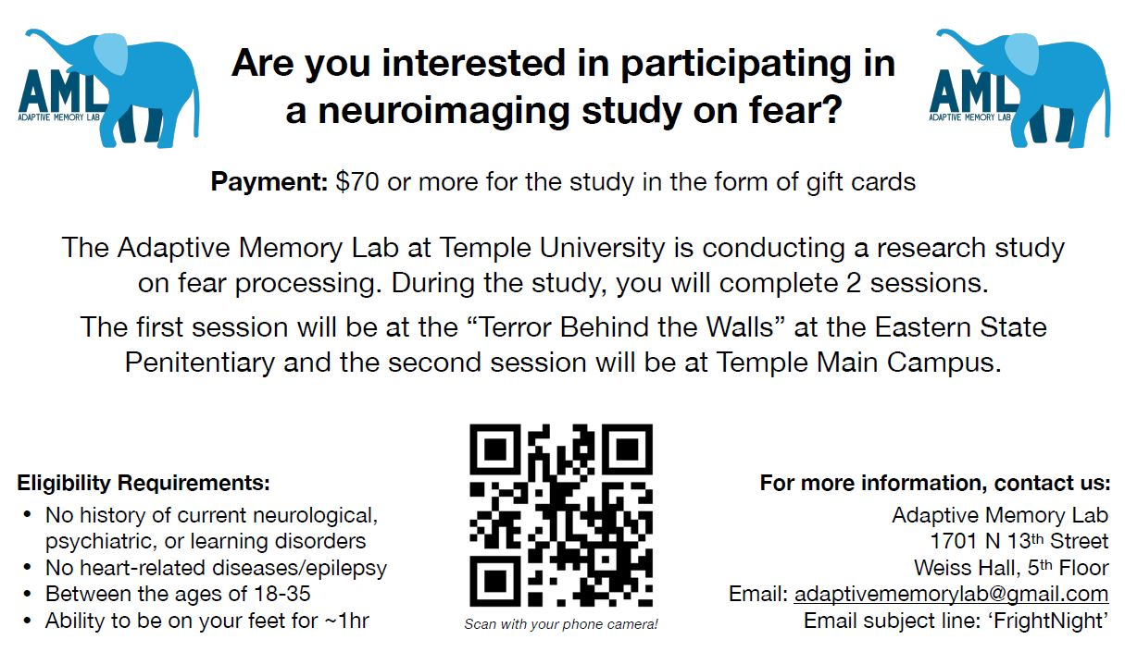
Notes:
When you advertise for a study on fear at a nationally famous haunted house
You have to assume certain types of participants are not responding to the ad

Slide 102
Self-selection bias
Still an artificial setting that might not generalize to daily life
Notes:
Although I believe that this design incorporates many of those features that I think to be important, it still is a fundamentally artificial environment.
When describing it, I’m hesitant to call it quasi-naturalistic and in fact often prefer something like “Dynamic and Feature-rich”

Slide 103

Self-selection bias
Still an artificial setting that might not generalize to daily life
Very resource intensive
Notes:
This was also a very resource intensive project which would not be possible without us being a very fortunate position to have received NSF funding for this project

Slide 104
Self-selection bias
Still an artificial setting that might not generalize to daily life
Very resource intensive
Difficult to execute / coordinate
Notes:
This project also required a ton of coordination, not only within the lab but with the folks running the attraction as well.

Slide 105
Self-selection bias
Still an artificial setting that might not generalize to daily life
Very resource intensive
Difficult to execute / coordinate
Difficult to analyze
Notes:
And lastly much of the data existed as free response and free recall data which required quite a lot of coding, and natural language processing to make usable

Slide 106
Greater study of environmental affordances
More naturalistic or high-immersion experiments
More meta-analyses to establish construct validity
Where to go from here?

Slide 107
When threats are …
Aversive
Unexpected
Dynamic
Complex
Compounded
People spontaneously self-regulated their emotions when feeling threatened
How people self-regulated their emotions was not significantly predicted by individual differences, affective intensity, cognitive load, or any other factor we commonly examine in the lab
A reemergence of canonical regulation relationships during Study 2 raises the question of the influence environmental affordances, such as time to process, in everyday self-regulation to threat

Slide 108
Notes:
And so even though these threats are not

Slide 109
Notes:
These threats, I think they offer a decent start to answering some of these types of questions

Slide 110
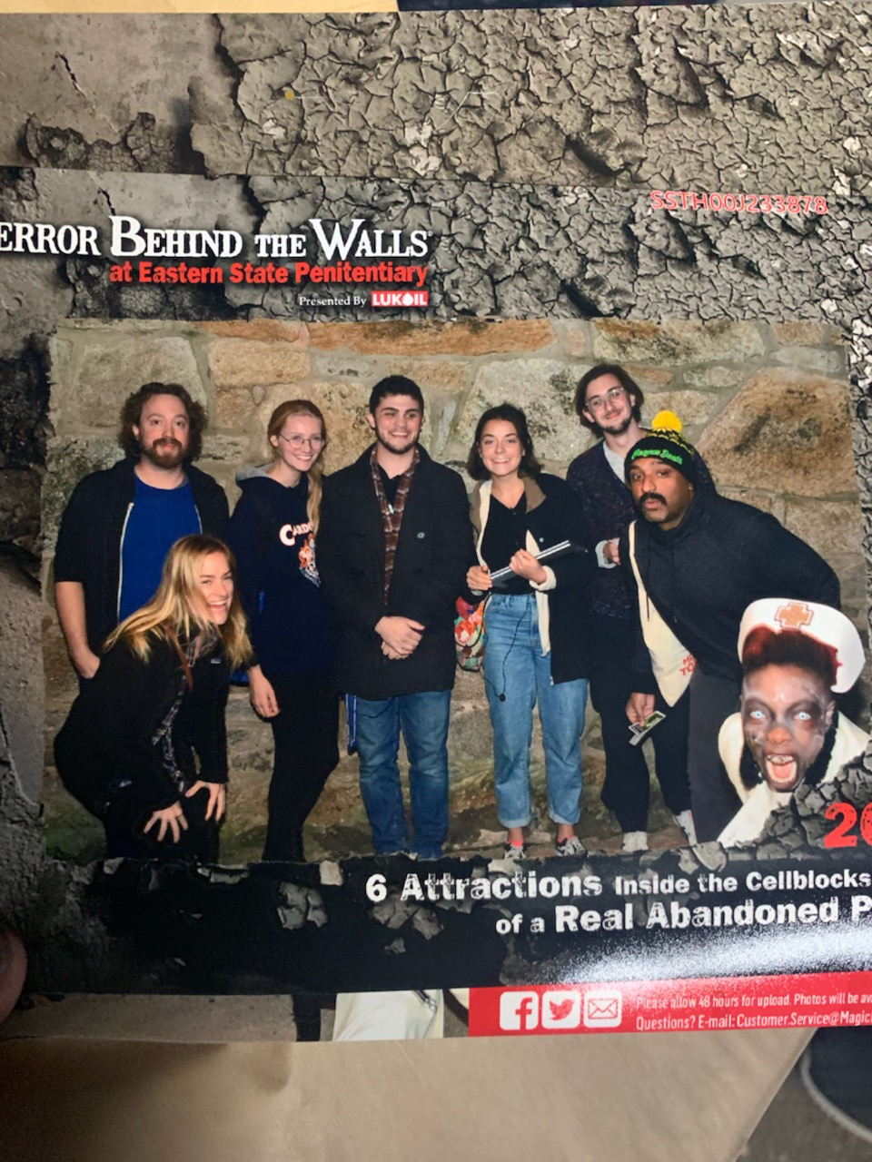

Sincere Appreciation to:
(Organized Alphabetically)
SAN Lab
Adhya Gowda
Chelsea Helion
Ian O’Shea
Helen Schmidt
Joanne Stasiak
AML Lab
Katelyn Cliver
Emily Cowan
Devlin Eckardt
Matthew Fain
Nicole Gonzalez
Dave Gregory
Kathryn Lockwood
Steven Martinez
Deepu Murty
Sam Reisman
Jane Rothrock
Notes:
Lastly, I just want to make sure to thank the people that helped me with this presentation and helped us build this project, between running sessions, data collections, scans, and analyzing. It really took a small army to pull off, and there were a lot of people that helped in big and small ways, so thank you to all of the members of the SAN Lab and the AML Lab.

Slide 111
QUESTIONS?

Slide 112
Setting: Eastern State Penitentiary in Philadelphia Pennsylvania 2019 (Study 1)
A ~45 minute haunted house experience divided into six distinctly-themed sections featuring dozens of actors on a pre-determined course filled with traps, fences, props, mazes, etc.

Slide 113
Setting: Eastern State Penitentiary in Philadelphia Pennsylvania 2022 (Study 2)
RENAMED
REMOVED
REMOVED
A ~35 minute haunted house experience divided into four distinctly-themed sections featuring dozens of actors on a pre-determined course filled with traps, fences, props, mazes, etc.

Slide 114



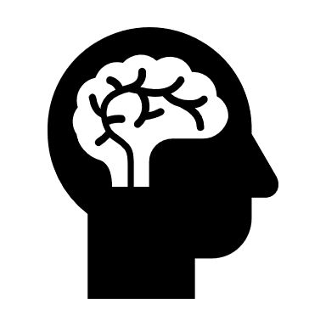
Data Collected
Physiology
Self-Report
Behavior
fMRI imaging

Slide 115
How am I conceptualizing threat in this context?
Setting Design
Labels made by creators
Number of relevant events
Self-Report
State STAI
Custom Measures
Cognitive Load (indirectly)
Physiology
Increased Heart Rate
Decreased Heart Rate Variability

Slide 116
Data Collected
Physiology
Self-Report
Behavior

Slide 117
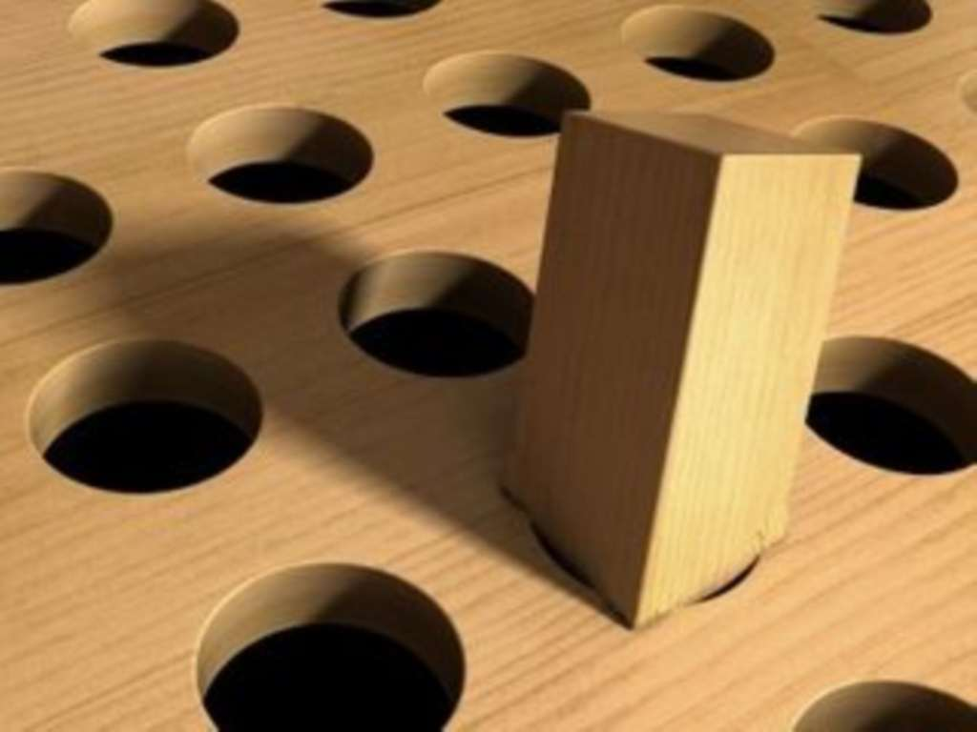
Some of these questions were not originally conceptualized through a threat framework specifically

Slide 118
What did this project teach us happens …
During threats
After threats
Emotion regulation is complex and colored by environmental affordances
Memory accuracy improves for some things and worsens for others

Slide 119
Memory Under Threat
Memories under threat, broadly, are prone to distortions, while memory confidence often remains in tact
Threat-related arousal can bias individuals to forget contextual information linking peripheral information of an item to its surrounding context in memory

Slide 120
Memory Under Threat
Memories under threat, broadly, are prone to distortions, while memory confidence often remains in tact
Threat-related arousal can bias individuals to forget contextual information linking peripheral information of an item to its surrounding context in memory
Most research has focused on threat-related disruptions to item-spatial binding or item-item binding, but not item-temporal context binding.

Slide 121
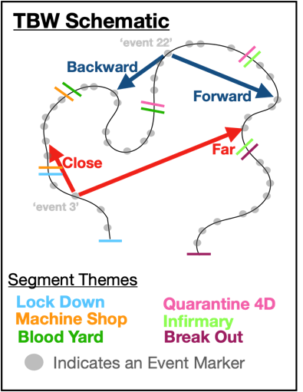
Memory Under Threat
Forward Transition
Proportion of events recalled backwards or forwards from last event in memory
Memories under threat, broadly, are prone to distortions, while memory confidence often remains in tact
Threat-related arousal can bias individuals to forget contextual information linking peripheral information of an item to its surrounding context in memory
Most research has focused on threat-related disruptions to item-spatial binding or item-item binding, but not item-temporal context binding.

Slide 122
Memory Under Threat
Forward Transition
Proportion of events recalled backwards or forwards from last event in memory
Memories under threat, broadly, are prone to distortions, while memory confidence often remains in tact
Threat-related arousal can bias individuals to forget contextual information linking peripheral information of an item to its surrounding context in memory
Most research has focused on threat-related disruptions to item-spatial binding or item-item binding, but not item-temporal context binding.

Slide 123
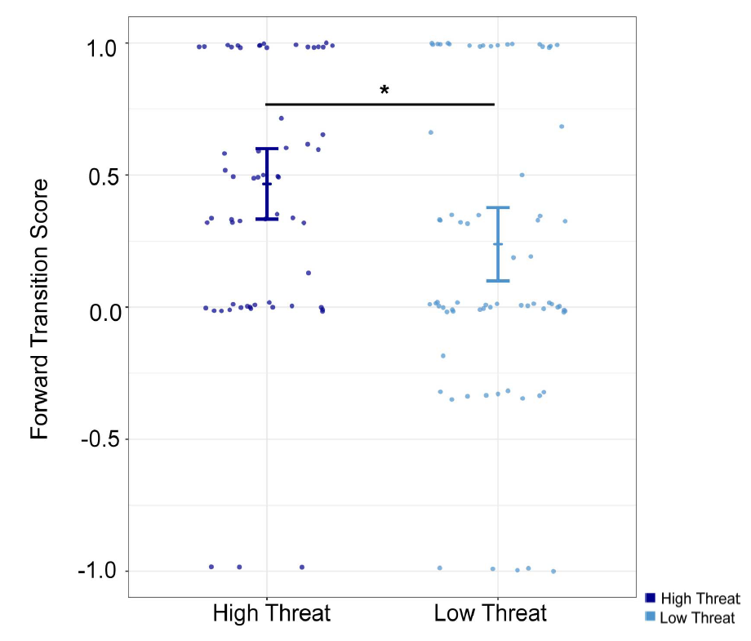
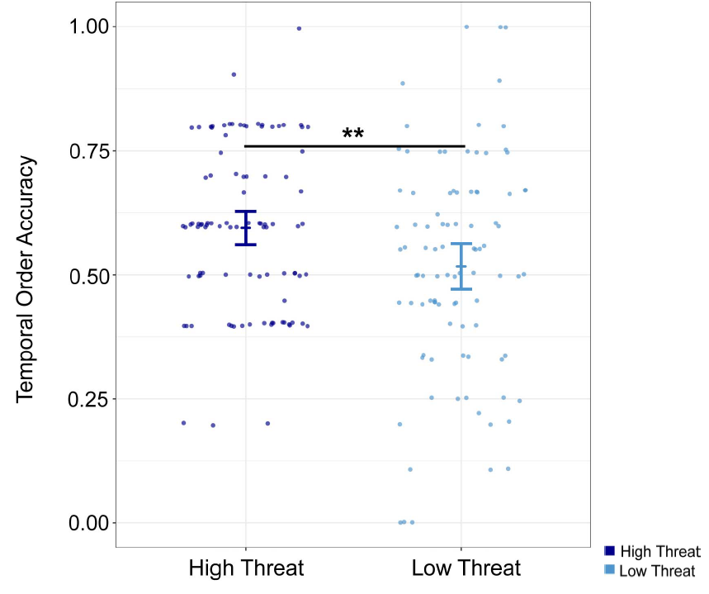
Threat improved temporal order memory (forward transitions in recall and recency discrimination judgments) ...
Forward Transition
Proportion of events recalled backwards or forwards from last event in memory

Slide 124
Threat improved temporal order memory (forward transitions in recall and recency discrimination judgments) ...
Forward Transition
Proportion of events recalled backwards or forwards from last event in memory

Slide 125
Threat improved temporal order memory (forward transitions in recall and recency discrimination judgments) ...
Forward Transition
Proportion of events recalled backwards or forwards from last event in memory

Slide 126
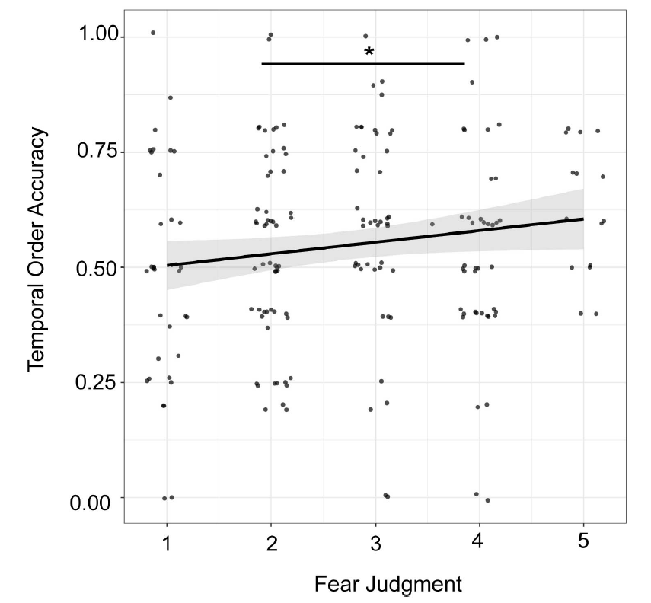
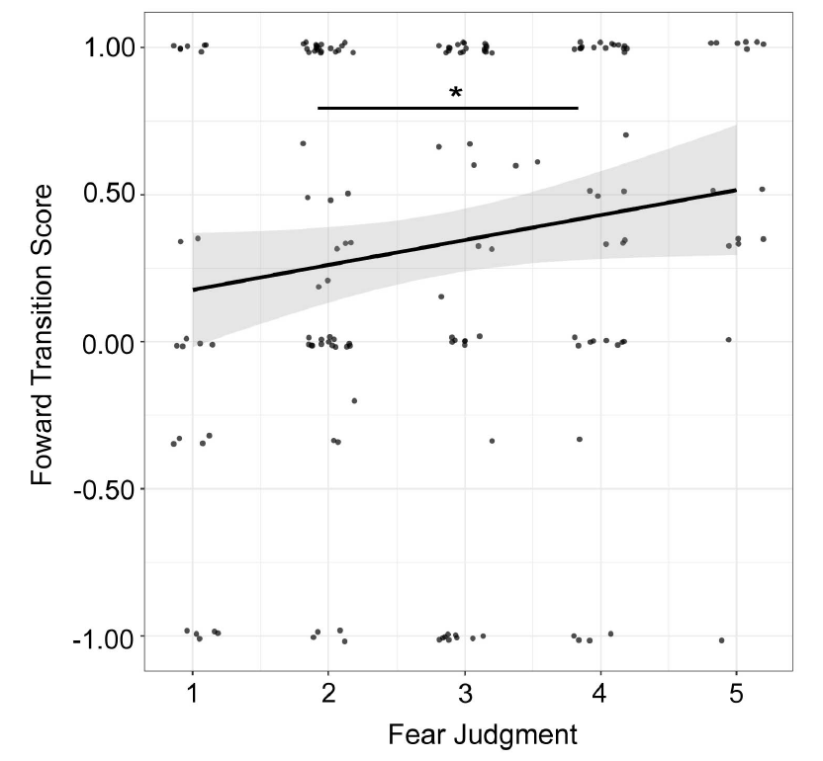
Threat improved temporal order memory (forward transitions in recall and recency discrimination judgments) ...
Forward Transition
Proportion of events recalled backwards or forwards from last event in memory
… and this was true using either objective measures of threat (i.e., pre-determined segments of the haunted house) or individually specific subjective measures of threats (i.e., fear judgments)

Slide 127
Threat improved temporal order memory (forward transitions in recall and recency discrimination judgments) ...
Forward Transition
Proportion of events recalled backwards or forwards from last event in memory
… and this was true using either objective measures of threat (i.e., pre-determined segments of the haunted house) or individually specific subjective measures of threats (i.e., fear judgments)

Slide 128
What did this project teach us happens …
During threats
After threats
Emotion regulation is complex and colored by environmental affordances
Memory accuracy improves for some things and worsens for others
Memory for temporal order and item-temporal order context actually seems to improve under threat

Slide 129
Emotional Memory Under Threat
Stimuli with emotional meaning tend to be remembered more often, and more accurately, than neutral stimuli
Elevated heart rate has been linked to enhanced autobiographical memory and increased recall accuracy for emotion-eliciting stimuli

Slide 130
Emotional Memory Under Threat
Stimuli with emotional meaning tend to be remembered more often, and more accurately, than neutral stimuli
Elevated heart rate has been linked to enhanced autobiographical memory and increased recall accuracy for emotion-eliciting stimuli
High levels of Norepinephrine – a primary neurotransmitter produced during stress – are associated with enhanced memory for emotional stimuli.

Slide 131
Emotional Memory Under Threat
Stimuli with emotional meaning tend to be remembered more often, and more accurately, than neutral stimuli
Elevated heart rate has been linked to enhanced autobiographical memory and increased recall accuracy for emotion-eliciting stimuli
High levels of Norepinephrine – a primary neurotransmitter produced during stress – are associated with enhanced memory for emotional stimuli.
Individuals report decreased intensity when applying discrete emotion labels to affective images relative to when the images are viewed without being labeled.

Slide 132
Emotional Memory Under Threat
Stimuli with emotional meaning tend to be remembered more often, and more accurately, than neutral stimuli
Elevated heart rate has been linked to enhanced autobiographical memory and increased recall accuracy for emotion-eliciting stimuli
High levels of Norepinephrine – a primary neurotransmitter produced during stress – are associated with enhanced memory for emotional stimuli.
Individuals report decreased intensity when applying discrete emotion labels to affective images relative to when the images are viewed without being labeled.

Slide 133
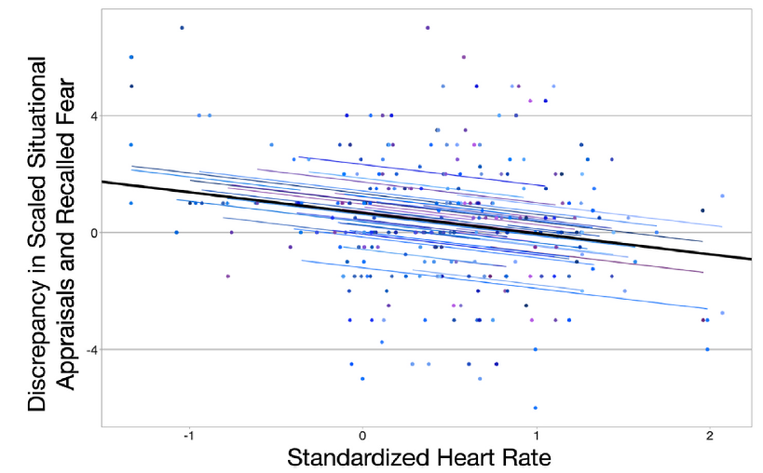
Emotional Memory Under Threat
Heart rate predicted both the intensity of reported scariness in the haunted house and meta-cognitive memory of affect during recall

Slide 134
Emotional Memory Under Threat
Heart rate predicted both the intensity of reported scariness in the haunted house and meta-cognitive memory of affect during recall

Slide 135
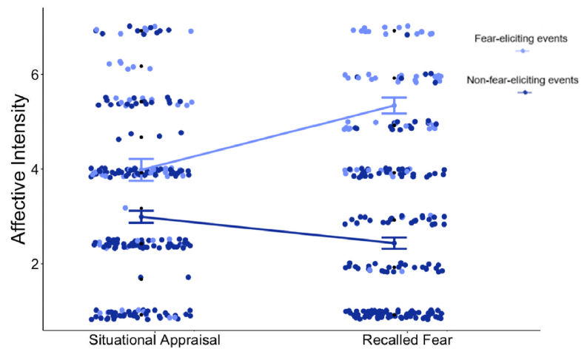
Emotional Memory Under Threat
Heart rate predicted both the intensity of reported scariness in the haunted house and meta-cognitive memory of affect during recall
Metacognitive emotional memory was malleable based on how the event was initially labeled.

Slide 136
Emotional Memory Under Threat
Heart rate predicted both the intensity of reported scariness in the haunted house and meta-cognitive memory of affect during recall
Metacognitive emotional memory was malleable based on how the event was initially labeled.

Slide 137
Emotional Memory Under Threat
Heart rate predicted both the intensity of reported scariness in the haunted house and meta-cognitive memory of affect during recall
Metacognitive emotional memory was malleable based on how the event was initially labeled.
Individuals tended to recall events that they explicitly labeled as fear-evoking as being more intense than they reported at the time of the event.

Slide 138
Pilot
(N = 58)
Study 2
(N = 154)
Study 1
(N = 118)
Study 3
(N = 253)
Notes:
So the first thing we did in 2019 was a pilot study in which participants traversed the full 45 minute haunted house experience
We based our a priori power analysis on the most conservative effect size that we could observe at the time,
which suggested that we should be able to sufficiently power this study with just 18 participants.
Obviously given the additional complications
and the fact that others had questions that required greater power,
we aimed for 60 participants and got 58.

Slide 139
Pilot
(N = 58)
Study 2
(N = 154)
Instructed to experience haunted house naturally
No emotion regulation training
Identified ten most emotionally-salient events
Recorded affective intensity, regulation effort and described strategy in their own words for each event
Strategies were coded (IRR = 0.881)
Study 1
(N = 118)
Study 3
(N = 253)
Notes:
These participants were given minimal instructions and information before entering the haunted house.

Slide 140
Pilot
(N = 58)
Study 2
(N = 154)
Instructed to experience haunted house naturally
No emotion regulation training
Identified ten most emotionally-salient events
Recorded affective intensity, regulation effort and described strategy in their own words for each event
Strategies were coded (IRR = 0.881)
Study 1
(N = 118)
Study 3
(N = 253)
Notes:
Emotion regulation was never mentioned and participants were not trained in strategies

Slide 141
Pilot
(N = 58)
Study 2
(N = 154)
Instructed to experience haunted house naturally
No emotion regulation training
Identified ten most emotionally-salient events
Recorded affective intensity, regulation effort and described strategy in their own words for each event
Strategies were coded (IRR = 0.881)
Study 1
(N = 118)
Study 3
(N = 253)
Notes:
Instead, after the full experience,
participants were asked to self-identify ten events from the haunted house
that were most emotionally salient to them

Slide 142
Pilot
(N = 58)
Study 2
(N = 154)
Instructed to experience haunted house naturally
No emotion regulation training
Identified ten most emotionally-salient events
Recorded affective intensity, regulation effort and described strategy in their own words for each event
Strategies were coded (IRR = 0.881)
Study 1
(N = 118)
Study 3
(N = 253)
Notes:
They identified which emotions they felt from 14 options sourced from the PANAS,
how intense they felt those emotions,
and then, in a free response box,
were asked to describe how they attempted to self-regulate those emotions if they did at all.
They also completed a number of individual difference measures.

Slide 143
Pilot
(N = 58)
Study 2
(N = 154)
Instructed to experience haunted house naturally
No emotion regulation training
Identified ten most emotionally-salient events
Recorded affective intensity, regulation effort and described strategy in their own words for each event
Strategies were coded (IRR = 0.881)
Study 1
(N = 118)
Study 3
(N = 253)
Notes:
Those strategy responses were then coded by a team of independent,
hypothesis-blind raters trained to identify strategies.
And from there what I really wanted to establish was just whether this paradigm has any legs.
Can we study self-regulation in this way?
And so what did we find?

Slide 144
Notes:
And while this safety makes these situations categorically different from the threats I’d just talked about,
haunted house experiences incorporate all of the features that are otherwise hard to fit in a lab experiment.
They can be aversive, they are surprising, the events unfold over time, they often contain an ample and varied amount of auditory, visual, and sensory stimuli, and the events do not exist in isolation.
Here are a few examples of the sights that our participants experienced at Terror Behind the Walls, hosted at Eastern State Penitentiary in Philadelphia.

Slide 145
What can TBTW offer?
Feature-rich but controlled environment
Notes:
We chose Terror Behind the Walls as our setting for a few reasons
One, this environment can feel really overwhelming and chaotic, but it is completely controlled. Participants can feel in danger without being in any real danger

Slide 146
What can TBTW offer?
Feature-rich but controlled environment
Limited researcher intervention
Notes:
Relatedly, it can be very easy to forget that you are participating in a study at terror behind the walls.
Because of fantastic coordination between our team and the people operating this,
we did not need a lot of researcher participant interaction during exposure
And our participants could focus on trying to have as typical of a response as the situation would allow

Slide 147
What can TBTW offer?
Feature-rich but controlled environment
Limited researcher intervention
Performances are reliably consistent
Notes:
We did not need to worry about significant variance in participant experiences
The TBTW team let our participants skip lines to ensure that
all of their highly trained professional actors were in the same marks every time

Slide 148
When feeling intense emotions, people self-regulated
People who do not enjoy haunted houses report regulating more events within the haunted house. r² adj. = 0.242

Slide 149
When feeling intense emotions, people self-regulated
People who do not enjoy haunted houses regulate more events within the haunted house. r² adj. = 0.242

Slide 150
When feeling intense emotions, people self-regulated
People who do not enjoy haunted houses regulate more events within the haunted house. r² adj. = 0.242
As startle sensitivity increases, the number of regulated events within the haunted house increases. r² adj. = 0.085

Slide 151
When feeling intense emotions, people self-regulated
People who do not enjoy haunted houses regulate more events within the haunted house. r² adj. = 0.242
As startle sensitivity increases, the number of regulated events within the haunted house increases. r² adj. = 0.085

Slide 152
When feeling intense emotions, people self-regulated
People who do not enjoy haunted houses regulate more events within the haunted house. r² adj. = 0.242
As startle sensitivity increases, the number of regulated events within the haunted house increases. r² adj. = 0.085
As anxiety increased within the haunted house, so did participants’ self-reported efforts to emotionally regulate. r² adj. = 0.095

Slide 153
When feeling intense emotions, people self-regulated
People who do not enjoy haunted houses regulate more events within the haunted house. r² adj. = 0.242
As startle sensitivity increases, the number of regulated events within the haunted house increases. r² adj. = 0.085
As anxiety increased within the haunted house, so did participants’ self-reported efforts to emotionally regulate. r² adj. = 0.095

Slide 154
When feeling intense emotions, people self-regulated
People who do not enjoy haunted houses regulate more events within the haunted house. r² adj. = 0.242
As startle sensitivity increases, the number of regulated events within the haunted house increases. r² adj. = 0.085
As anxiety increased within the haunted house, so did participants’ self-reported efforts to emotionally regulate. r² adj. = 0.095
As negative affective intensity increased, people put more effort towards regulating their emotions.

Slide 155
When feeling intense emotions, people self-regulated
People who do not enjoy haunted houses regulate more events within the haunted house. r² adj. = 0.242
As startle sensitivity increases, the number of regulated events within the haunted house increases. r² adj. = 0.085
As anxiety increased within the haunted house, so did participants’ self-reported efforts to emotionally regulate. r² adj. = 0.095
As negative affective intensity increased for a given event, people put more effort towards regulating their emotions during that event.

Slide 156
Pilot
(N = 58)
Study 2
(N = 154)
Largely the same as Pilot except no time lag
Emotions were also free-response
Strategies were coded again (IRR = 0.877)
Instructed to experience haunted house naturally
No emotion regulation training
Identified ten most emotionally-salient events
Recorded affective intensity, regulation effort and described strategy in their own words for each event
Strategies were coded (IRR = 0.881)
Study 1
(N = 118)
Study 3
(N = 253)
Notes:
This time we included 118 people
Using observed effect from pilot
No time lag

Slide 157
Pilot
(N = 58)
Study 2
(N = 154)
Largely the same as Pilot except no time lag
Emotions were also free-response
Strategies were coded again (IRR = 0.877)
Instructed to experience haunted house naturally
No emotion regulation training
Identified ten most emotionally-salient events
Recorded affective intensity, regulation effort and described strategy in their own words for each event
Strategies were coded (IRR = 0.881)
Study 1
(N = 118)
Study 3
(N = 253)

Slide 158
Pilot
(N = 58)
Study 2
(N = 154)
Largely the same as Pilot except no time lag
Emotions were also free-response
Strategies were coded again (IRR = 0.877)
Instructed to experience haunted house naturally
No emotion regulation training
Identified ten most emotionally-salient events
Recorded affective intensity, regulation effort and described strategy in their own words for each event
Strategies were coded (IRR = 0.881)
Study 1
(N = 118)
Study 3
(N = 253)

Slide 159
We are certainly self-regulating, but how we do so is complicated ...
Affective intensity did not predict which strategy participants used when regulating their emotions in this context.

Slide 160
We are certainly self-regulating, but how we do so is complicated ...
Affective intensity did not predict which strategy participants used when regulating their emotions in this context.

Slide 161
We are certainly self-regulating, but how we do so is complicated ...
Affective intensity did not predict which strategy participants used when regulating their emotions in this context.
This was true even when taking a multiverse approach and adjusting for known covariates including cognitive load, sex, and ERQ scores.

Slide 163
At least part of the reason that it may be complicated is that ...
Reappraisal performed about evenly at all levels of intensity, while distraction got worse as intensity increases
This is contrary to what previous lab research might suggest

Slide 164
At least part of the reason that it may be complicated is that ...
Reappraisal performed about evenly at all levels of intensity, while distraction got worse as intensity increases
This is contrary to what previous lab research might suggest

Slide 165
Regulation Strategy Choice
Regulation Strategy Use
Notes:
Idealized
Trained
Prompted

Slide 166

Regulation Strategy Choice
Regulation Strategy Use
Regulation Strategy Forecasting
Notes:
Existing somewhere in between having characteristics of each

Slide 167
If Use doesn’t match Choice, which is Forecasting more similar to?

Slide 168
Pilot
(N = 58)
Study 2
(N = 154)
Largely the same as Pilot except no time lag
Emotions were also free-response
Strategies were coded again (IRR = 0.877)
Instructed to experience haunted house naturally
No emotion regulation training
Identified ten most emotionally-salient events
Recorded affective intensity, regulation effort and described strategy in their own words for each event
Strategies were coded (IRR = 0.881)
Conducted entirely online with people who had never seen the haunted house
Fed descriptions of events, affective information,
Asked to predict which strategy they would have used.
More closely mirrors the stimulus-response paradigms
Study 1
(N = 118)
Study 3
(N = 253)

Slide 169
Pilot
(N = 58)
Study 2
(N = 154)
Largely the same as Pilot except no time lag
Emotions were also free-response
Strategies were coded again (IRR = 0.877)
Instructed to experience haunted house naturally
No emotion regulation training
Identified ten most emotionally-salient events
Recorded affective intensity, regulation effort and described strategy in their own words for each event
Strategies were coded (IRR = 0.881)
Conducted entirely online with people who had never seen the haunted house
Fed descriptions of events, affective information
Asked to predict which strategy they would have used.
More closely mirrors the stimulus-response paradigms
Study 1
(N = 118)
Study 3
(N = 253)

Slide 170
Pilot
(N = 58)
Study 2
(N = 154)
Largely the same as Pilot except no time lag
Emotions were also free-response
Strategies were coded again (IRR = 0.877)
Instructed to experience haunted house naturally
No emotion regulation training
Identified ten most emotionally-salient events
Recorded affective intensity, regulation effort and described strategy in their own words for each event
Strategies were coded (IRR = 0.881)
Conducted entirely online with people who had never seen the haunted house
Fed descriptions of events, affective information
Asked to predict which strategy they would have used.
More closely mirrors the stimulus-response paradigms
Study 1
(N = 118)
Study 3
(N = 253)

Slide 171
Pilot
(N = 58)
Study 2
(N = 154)
Largely the same as Pilot except no time lag
Emotions were also free-response
Strategies were coded again (IRR = 0.877)
Instructed to experience haunted house naturally
No emotion regulation training
Identified ten most emotionally-salient events
Recorded affective intensity, regulation effort and described strategy in their own words for each event
Strategies were coded (IRR = 0.881)
Conducted entirely online with people who had never seen the haunted house
Fed descriptions of events, affective information
Asked to predict which strategy they would have used.
More closely mirrors the stimulus-response paradigms
Study 1
(N = 118)
Study 3
(N = 253)

Slide 173
When forecasting emotion regulation ...
We see a similar pattern of results to what ER researchers have canonically found (albeit, a much weaker association); increased affective intensity predicts a greater likelihood of selecting distraction instead of reappraisal
OR = 1.06, 95% CI = [1.02, 1.10], p = 0.004
Notes:
, likely because Forecasters were specifically using the strategy at higher intensities; the situation which experiencers found themselves the least likely to successfully deploy distraction.
, which might makes sense if we have one group effectively choosing reappraisal at chance

Slide 174
When forecasting emotion regulation ...
We see a similar pattern of results to what ER researchers have canonically found (albeit, a much weaker association); increased affective intensity predicts a greater likelihood of selecting distraction instead of reappraisal
OR = 1.06, 95% CI = [1.02, 1.10], p = 0.004
These differences were not explained by differences between the samples in ERQ, DERS, or IUS
Notes:
, likely because Forecasters were specifically using the strategy at higher intensities; the situation which experiencers found themselves the least likely to successfully deploy distraction.
, which might makes sense if we have one group effectively choosing reappraisal at chance

Slide 175
When forecasting emotion regulation ...
We see a similar pattern of results to what ER researchers have canonically found (albeit, a much weaker association); increased affective intensity predicts a greater likelihood of selecting distraction instead of reappraisal
OR = 1.06, 95% CI = [1.02, 1.10], p = 0.004
These differences were not explained by differences between the samples in ERQ, DERS, or IUS
Forecasters matched Reappraisal at about chance. However, forecasters were much less accurate in matching Distraction, adjusting for frequency differences.
Notes:
, likely because Forecasters were specifically using the strategy at higher intensities; the situation which experiencers found themselves the least likely to successfully deploy distraction.
, which might makes sense if we have one group effectively choosing reappraisal at chance

Slide 176

Pilot
(N = 58)
Study 2
(N = 154)
Largely the same as Pilot except no time lag
Emotions were also free-response
Strategies were coded again (IRR = 0.877)
Conducted online using horror movie stimuli
Seeks to disentangle the forecasting/experiencing and stimulation –level
confound
Instructed to experience haunted house naturally
No emotion regulation training
Identified ten most emotionally-salient events
Recorded affective intensity, regulation effort and described strategy in their own words for each event
Strategies were coded (IRR = 0.881)
Conducted entirely online with people who had never seen the haunted house
Fed descriptions of events, affective information,
Asked to predict which strategy they would have used.
More closely mirrors the stimulus-response paradigms
Study 1
(N = 118)
Study 3
(N = 253)

Slide 177
Pilot
(N = 58)
Study 2
(N = 154)
Largely the same as Pilot except no time lag
Emotions were also free-response
Strategies were coded again (IRR = 0.877)
Conducted online using horror movie stimuli
Captured both forecasting and experiencing usage using high and low intensity stimuli
Instructed to experience haunted house naturally
No emotion regulation training
Identified ten most emotionally-salient events
Recorded affective intensity, regulation effort and described strategy in their own words for each event
Strategies were coded (IRR = 0.881)
Conducted entirely online with people who had never seen the haunted house
Fed descriptions of events, affective information,
Asked to predict which strategy they would have used.
More closely mirrors the stimulus-response paradigms
Study 1
(N = 118)
Study 3
(N = 253)

Slide 178
Pilot
(N = 58)
Study 2
(N = 154)
Largely the same as Pilot except no time lag
Emotions were also free-response
Strategies were coded again (IRR = 0.877)
Conducted online using horror movie stimuli
Captured both forecasting and experiencing usage using high and low intensity stimuli
Mirrored many aspects of Study 1
Instructed to experience haunted house naturally
No emotion regulation training
Identified ten most emotionally-salient events
Recorded affective intensity, regulation effort and described strategy in their own words for each event
Strategies were coded (IRR = 0.881)
Conducted entirely online with people who had never seen the haunted house
Fed descriptions of events, affective information,
Asked to predict which strategy they would have used.
More closely mirrors the stimulus-response paradigms
Study 1
(N = 118)
Study 3
(N = 253)

Slide 179
When comparing usage and forecasting in more controlled circumstances...
At lower intensities, forecasters are less likely to select reappraisal than experiencers were to use reappraisal.
OR = 0.61, 95% CI = [0.39, 0.95], p = 0.029
Notes:
, likely because Forecasters were specifically using the strategy at higher intensities; the situation which experiencers found themselves the least likely to successfully deploy distraction.
, which might makes sense if we have one group effectively choosing reappraisal at chance

Slide 180
When comparing usage and forecasting in more controlled circumstances...
At lower intensities, forecasters are less likely to select reappraisal than experiencers were to use reappraisal.
OR = 0.61, 95% CI = [0.39, 0.95], p = 0.029
Notes:
, likely because Forecasters were specifically using the strategy at higher intensities; the situation which experiencers found themselves the least likely to successfully deploy distraction.
, which might makes sense if we have one group effectively choosing reappraisal at chance

Slide 181
When comparing usage and forecasting in more controlled circumstances...
[
At lower intensities, forecasters are less likely to select reappraisal than experiencers were to use reappraisal.
OR = 0.61, 95% CI = [0.39, 0.95], p = 0.029
Notes:
, likely because Forecasters were specifically using the strategy at higher intensities; the situation which experiencers found themselves the least likely to successfully deploy distraction.
, which might makes sense if we have one group effectively choosing reappraisal at chance

Slide 182
***
When comparing usage and forecasting in more controlled circumstances...
At lower intensities, forecasters are less likely to select reappraisal than experiencers were to use reappraisal.
OR = 0.61, 95% CI = [0.39, 0.95], p = 0.029
Forecasters were much more likely to select regulation over forecasters
Notes:
, likely because Forecasters were specifically using the strategy at higher intensities; the situation which experiencers found themselves the least likely to successfully deploy distraction.
, which might makes sense if we have one group effectively choosing reappraisal at chance

Slide 183
When comparing usage and forecasting in more controlled circumstances...
**
At lower intensities, forecasters are less likely to select reappraisal than experiencers were to use reappraisal.
OR = 0.61, 95% CI = [0.39, 0.95], p = 0.029
Forecasters were much more likely to select regulation over forecasters
However, forecasters used the strategies much more evenly than did experiencers, who relied more on reappraisal.
Notes:
, likely because Forecasters were specifically using the strategy at higher intensities; the situation which experiencers found themselves the least likely to successfully deploy distraction.
, which might makes sense if we have one group effectively choosing reappraisal at chance

Slide 184
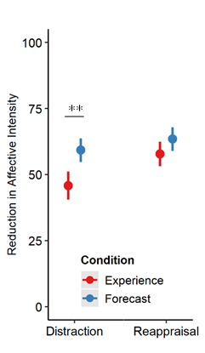
When comparing usage and forecasting in more controlled circumstances...
Forecasters predicted that distraction would reduce affective intensity when used more than experiencers reported that it actually had.
x̄ _{Experience} = 48.0 | x̄ _{Forecast} = 58.3
95% CI = [-16.62, -4.13]
t(198.2) = -3.28, p = 0.001
Notes:
, likely because Forecasters were specifically using the strategy at higher intensities; the situation which experiencers found themselves the least likely to successfully deploy distraction.
, which might makes sense if we have one group effectively choosing reappraisal at chance

Slide 185
When events are …
Aversive
Uncertain
Dynamic
Complex
People spontaneously self-regulated their emotions
How people self-regulate their emotions is not significantly predicted by individual differences, affective intensity, cognitive load, or any other factor we commonly examine in the lab
Forecasting may still reflect the canonical regulation relationships, which raises questions of how environmental affordances, such as time to process, influence everyday self-regulation
Distraction was consistently less effective in use than might be expected by choice paradigms or forecasters.

Slide 186
Notes:
But I should also be very up front about our limitations

Slide 187
Self-selection bias
Notes:
We cannot deny the likelihood that some self-selection bias was at play here.
We tried our best to monitor this and test this. We did find quite a bit of diversity in the distribution of participant responses to questions like “How much do you enjoy or are fearful of haunted houses?”
We captured participant expectations and motivations for participation. But no matter what

Slide 188
Notes:
When you advertise for a study on fear at a nationally famous haunted house
You have to assume certain types of participants are not responding to the ad

Slide 189
Self-selection bias
Still an artificial setting that might not generalize to daily life
Notes:
Although I believe that this design incorporates many of those features that I think to be important, it still is a fundamentally artificial environment.
When describing it, I’m hesitant to call it quasi-naturalistic and in fact often prefer something like “Dynamic and Feature-rich”

Slide 190
Self-selection bias
Still an artificial setting that might not generalize to daily life
Very resource intensive
Notes:
This was also a very resource intensive project which would not be possible without us being a very fortunate position to have received NSF funding for this project

Slide 191
Self-selection bias
Still an artificial setting that might not generalize to daily life
Very resource intensive
Difficult to execute / coordinate
Notes:
This project also required a ton of coordination, not only within the lab but with the folks running the attraction as well.

Slide 192
Self-selection bias
Still an artificial setting that might not generalize to daily life
Very resource intensive
Difficult to execute / coordinate
Difficult to analyze
Notes:
And lastly much of the data existed as free response and free recall data which required quite a lot of coding, and natural language processing to make usable

Slide 193
Sincere Appreciation to:
(Organized Alphabetically)
SAN Lab
Adhya Gowda
Chelsea Helion
Ian O’Shea
Helen Schmidt
Joanne Stasiak
AML Lab
Katelyn Cliver
Emily Cowan
Devlin Eckardt
Matthew Fain
Nicole Gonzalez
Dave Gregory
Kathryn Lockwood
Steven Martinez
Deepu Murty
Sam Reisman
Jane Rothrock
Notes:
Lastly, I just want to make sure to thank the people that helped me with this presentation and helped us build this project, between running sessions, data collections, scans, and analyzing. It really took a small army to pull off, and there were a lot of people that helped in big and small ways, so thank you to all of the members of the SAN Lab and the AML Lab.

Slide 194
QUESTIONS?

